Slide 1
A Study of Remining Practices within the Cambria District
Mike Haney, PG
Rock Martin, PG
Mike Schirato, PG
Greg Shuler, PG
PADEP Cambria District Mining Office

Slide 2
Cambria District Mining: Remining Review
Objectives: To review data from remining sites within the Cambria District to identify trends
  Expand geographical and statistical coverage of previous research
  Refine the categorical analysis by sorting results
    County
    Watershed
    Coal Seam
Identify specific topics for further study
Illustrate practical application of conclusions

Slide 3
Pennsylvania Bituminous Remining: Previous Research
M.W. Smith, K.B.C. Brady, and J. W. Hawkins presented research from 1995 to 2002. (up to 233 discharges within 110 sites)
Statistical comparison of pollutional loading from pre-existing discharges on remined sites
Baseline vs. post-mining
Abatement techniques, etc.

Slide 4
Pennsylvania Bituminous Remining: Previous Research
Results were derived from a comparison of pre- vs. post-mining analytical data that displayed a statistically significant median value change about a 95% confidence interval range.
This study uses the same qualifying criteria and overall analysis methodology
Refinement sorting and graphical illustration/mapping displays
Previous work defined and identified qualifying site data as:
Pre-existing pollutional discharge data wherein baseline loading values could be established and compared to post-mining datasets
A minimum of 12 time-series data points collected over a hydrologic year
Sorted by relevant mining parameter
Extra data could be used to assess remining methods/abatement techniques

Slide 5
233 discharges within 110 sites. 6 sites within the Cambria Mining District

Slide 6
101 discharges within 25 sites all within the Cambria Mining District

Slide 7
Data Sourcing:
Digital tracking of surface mine permits with Pa Title 25 Chapter 87 Subchapter F protection.
Physical files of sites that qualified (mining complete, bond released)
  Module 26:Remining / Baseline calculations / coal seam info/ method
  Module 8 background data
Microfilm of archived sites
Qualification review: minimum 12 time-series dataset; corresponding post-mining dataset
Baseline calculation correction/update for statistical comparison

Slide 8
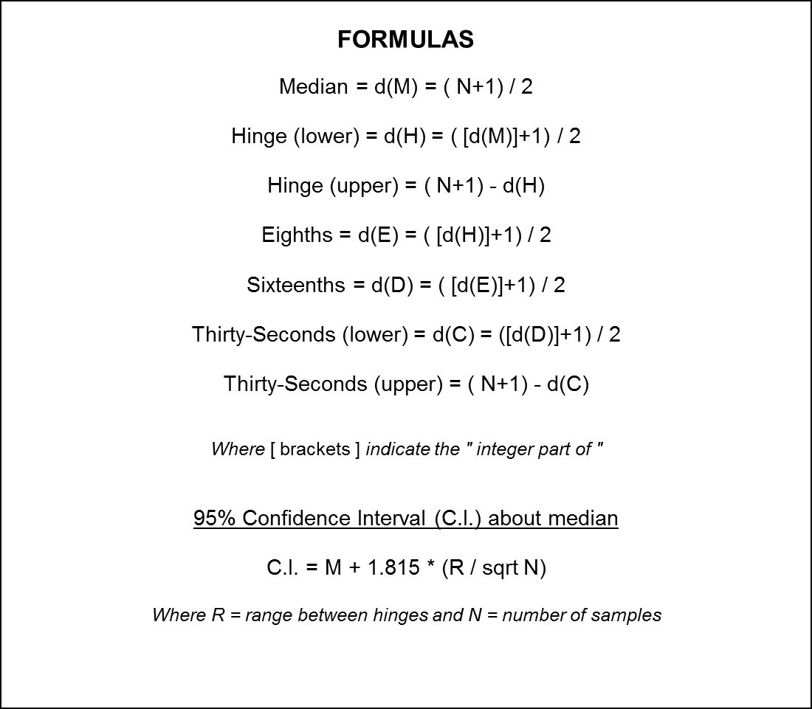
Baseline calculation confidence interval correction:
This allowed for:
- Parameter by Parameter comparison for pre-existing, pre-mining discharge baseline data vs. post-mining monitoring data obtained prior to bond release.
- Compilation of data across the study area for geographical sorting

Slide 9
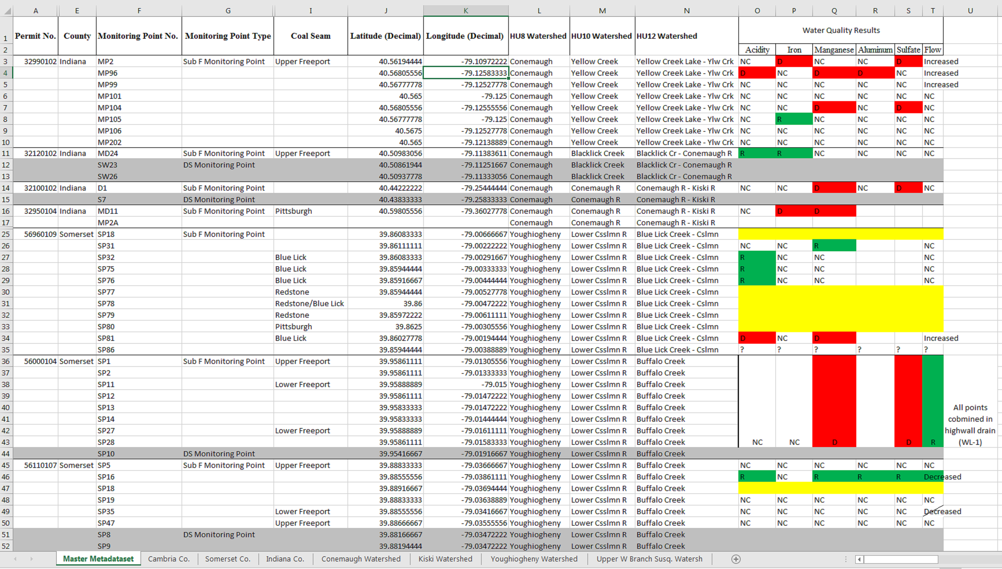
Discharge Eliminated by Remining
Discharge Degraded by Remining
Discharge Improved by Remining
No Post Mining Change

Slide 10
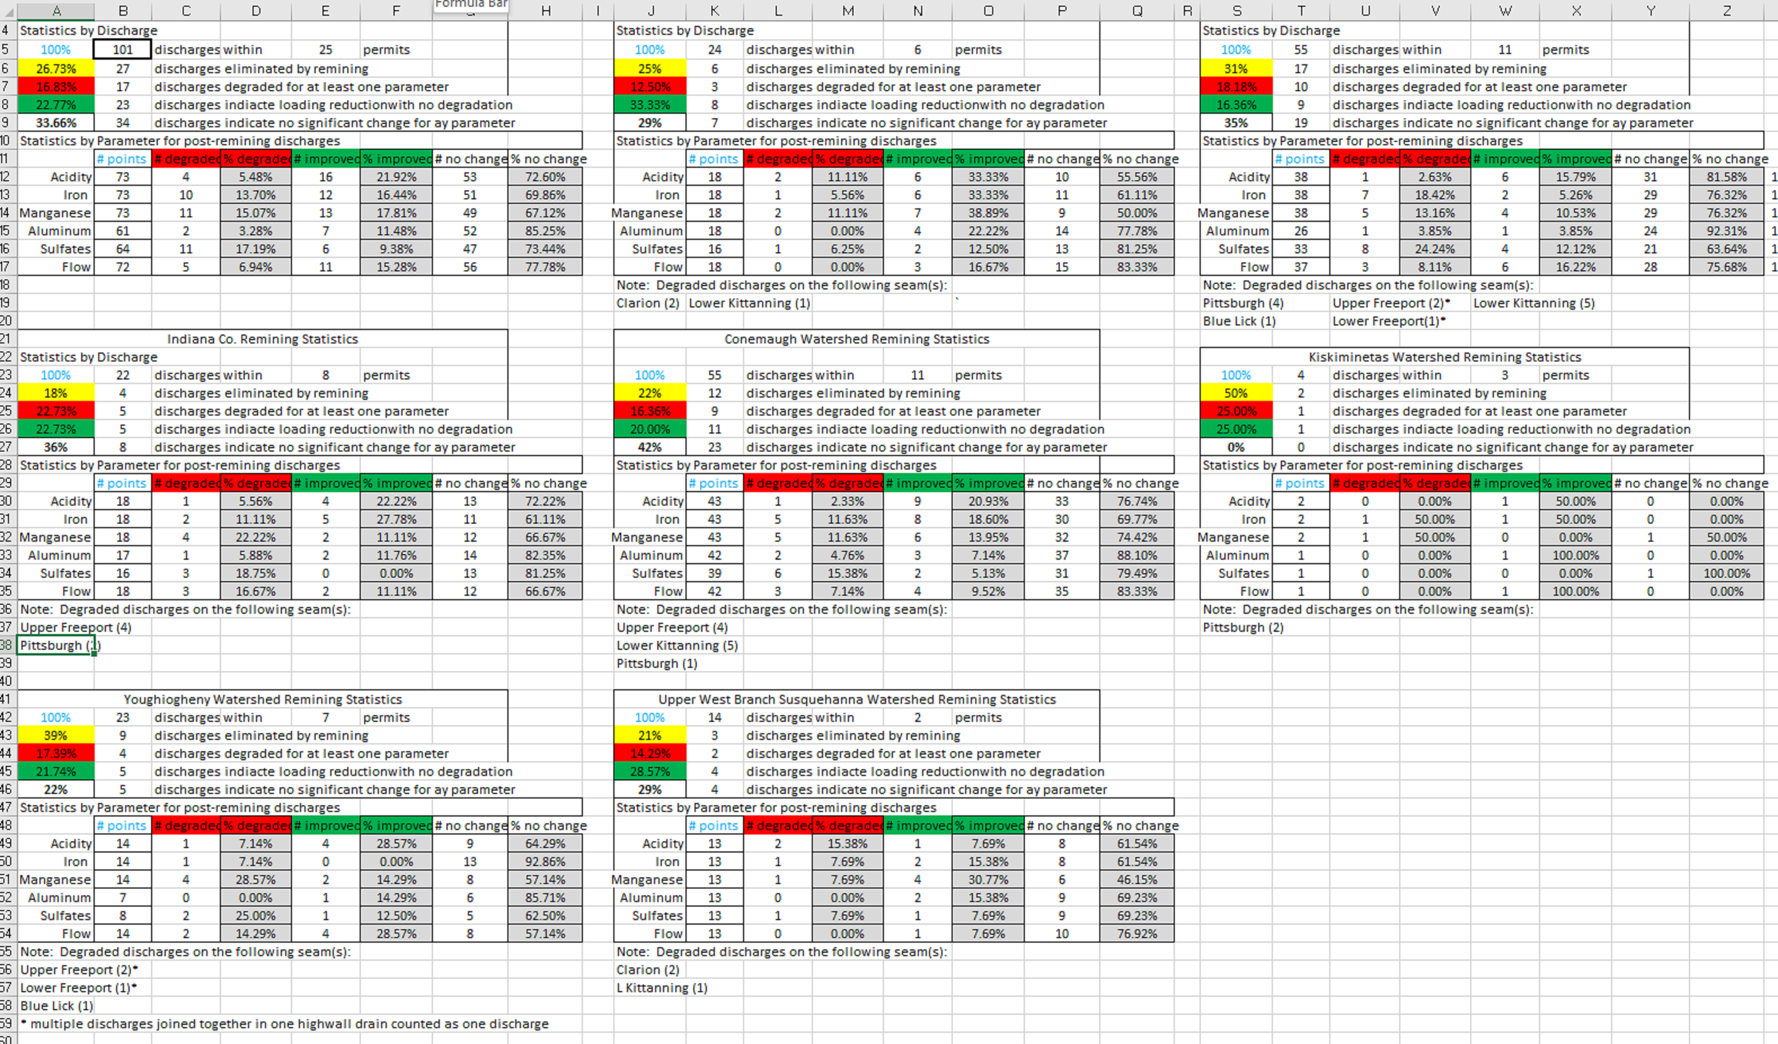
Discharge Eliminated by Remining
Discharge Degraded by Remining
Discharge Improved by Remining
No Post Mining Change

Slide 11
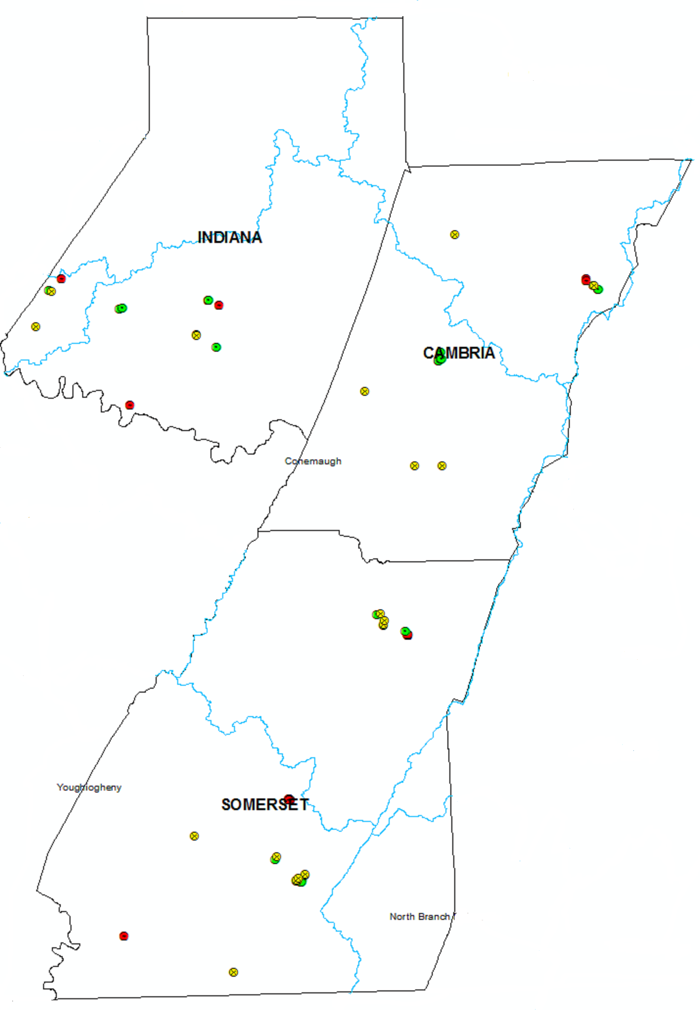
Statistics by Discharge
100% | 101 | discharges | within | 25 | permits
26.73% | 27 | discharges eliminated by remining
16.83% | 18 | discharges degraded for at least one parameter
22.77% | 23 | discharges indicate loading reduction with no degradation
33.66% | 33 | discharges indicate no significant change for ay parameter
Statistics by Parameter for post-remining discharges
 | # points | # degraded | % degraded | # improved | % improved | # no change | % no change
Acidity | 73 | 4 | 5.48% | 16 | 21.92% | 53 | 72.60%
Iron | 73 | 10 | 13.70% | 12 | 16.44% | 51 | 69.86%
Manganese | 73 | 11 | 15.07% | 13 | 17.81% | 49 | 67.12%
Aluminum | 61 | 2 | 3.28% | 7 | 11.48% | 52 | 85.25%
Sulfates | 64 | 11 | 17.19% | 6 | 9.38% | 47 | 73.44%
Flow | 72 | 5 | 6.94% | 11 | 15.28% | 56 | 77.78%
Discharge Eliminated by Remining
Discharge Degraded by Remining
Discharge Improved by Remining
No Post Mining Change
Color coding scheme was applied to GIS graphics for each discharge location for reference

Slide 12
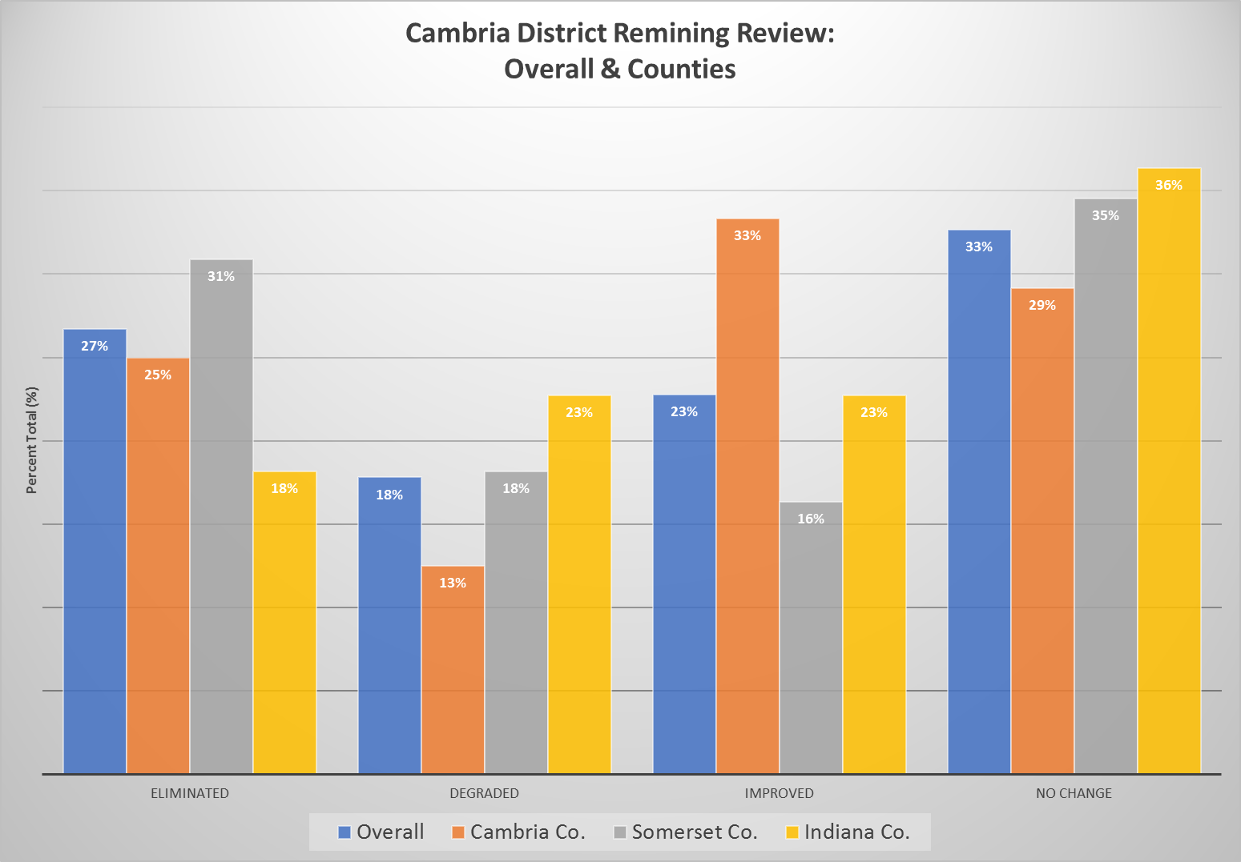

Slide 15
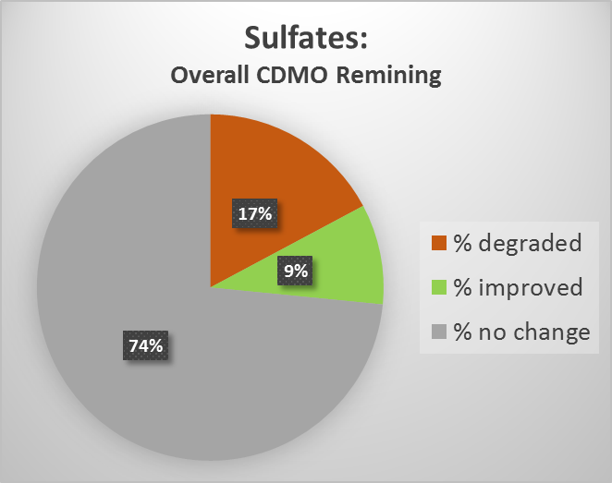
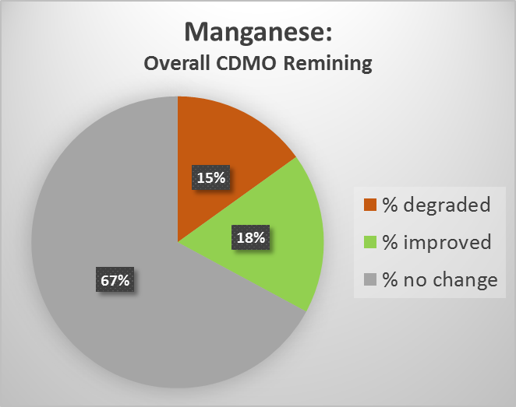
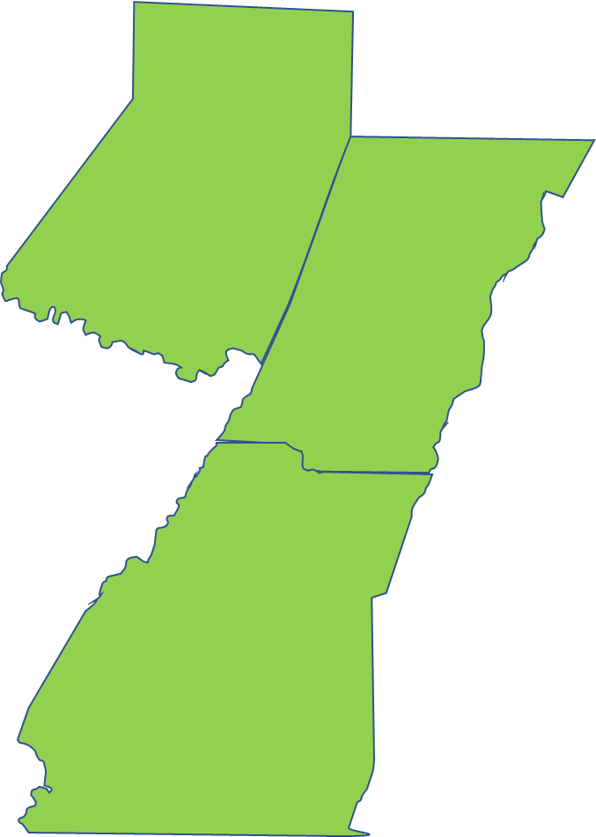
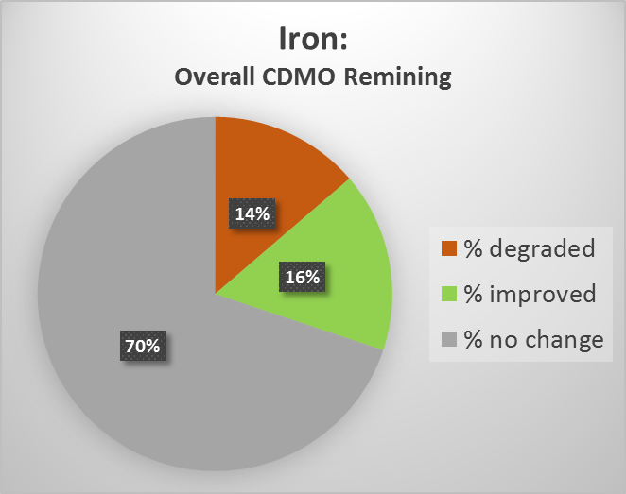
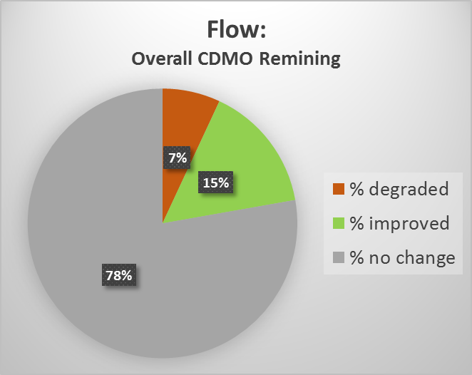
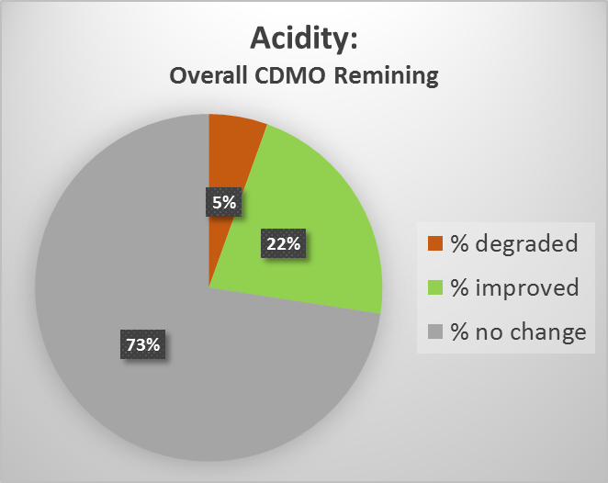
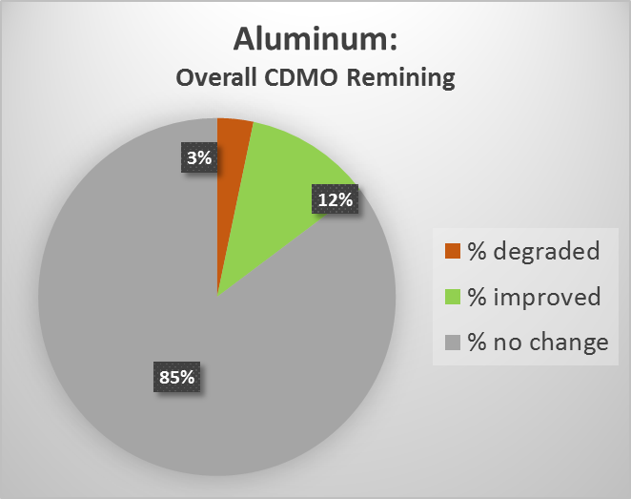
Overall Cambria District: Remining Review

Slide 16
17%
28%
55%

Slide 17
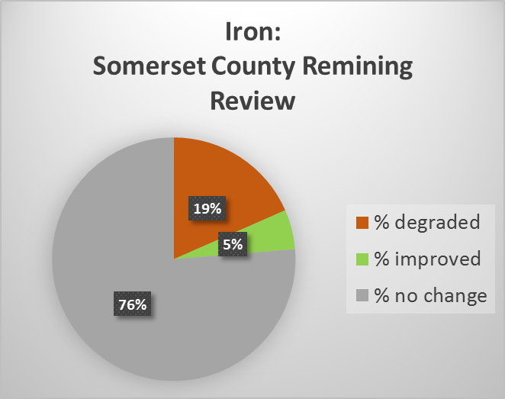
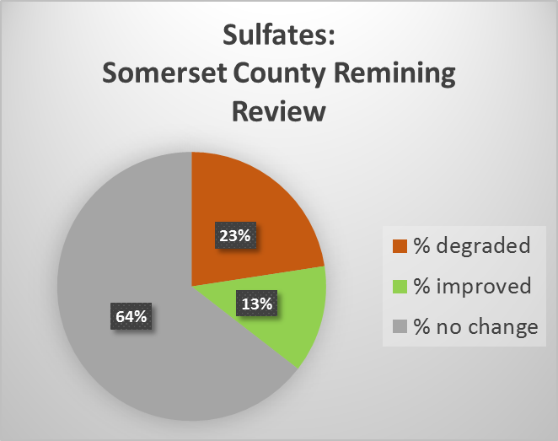
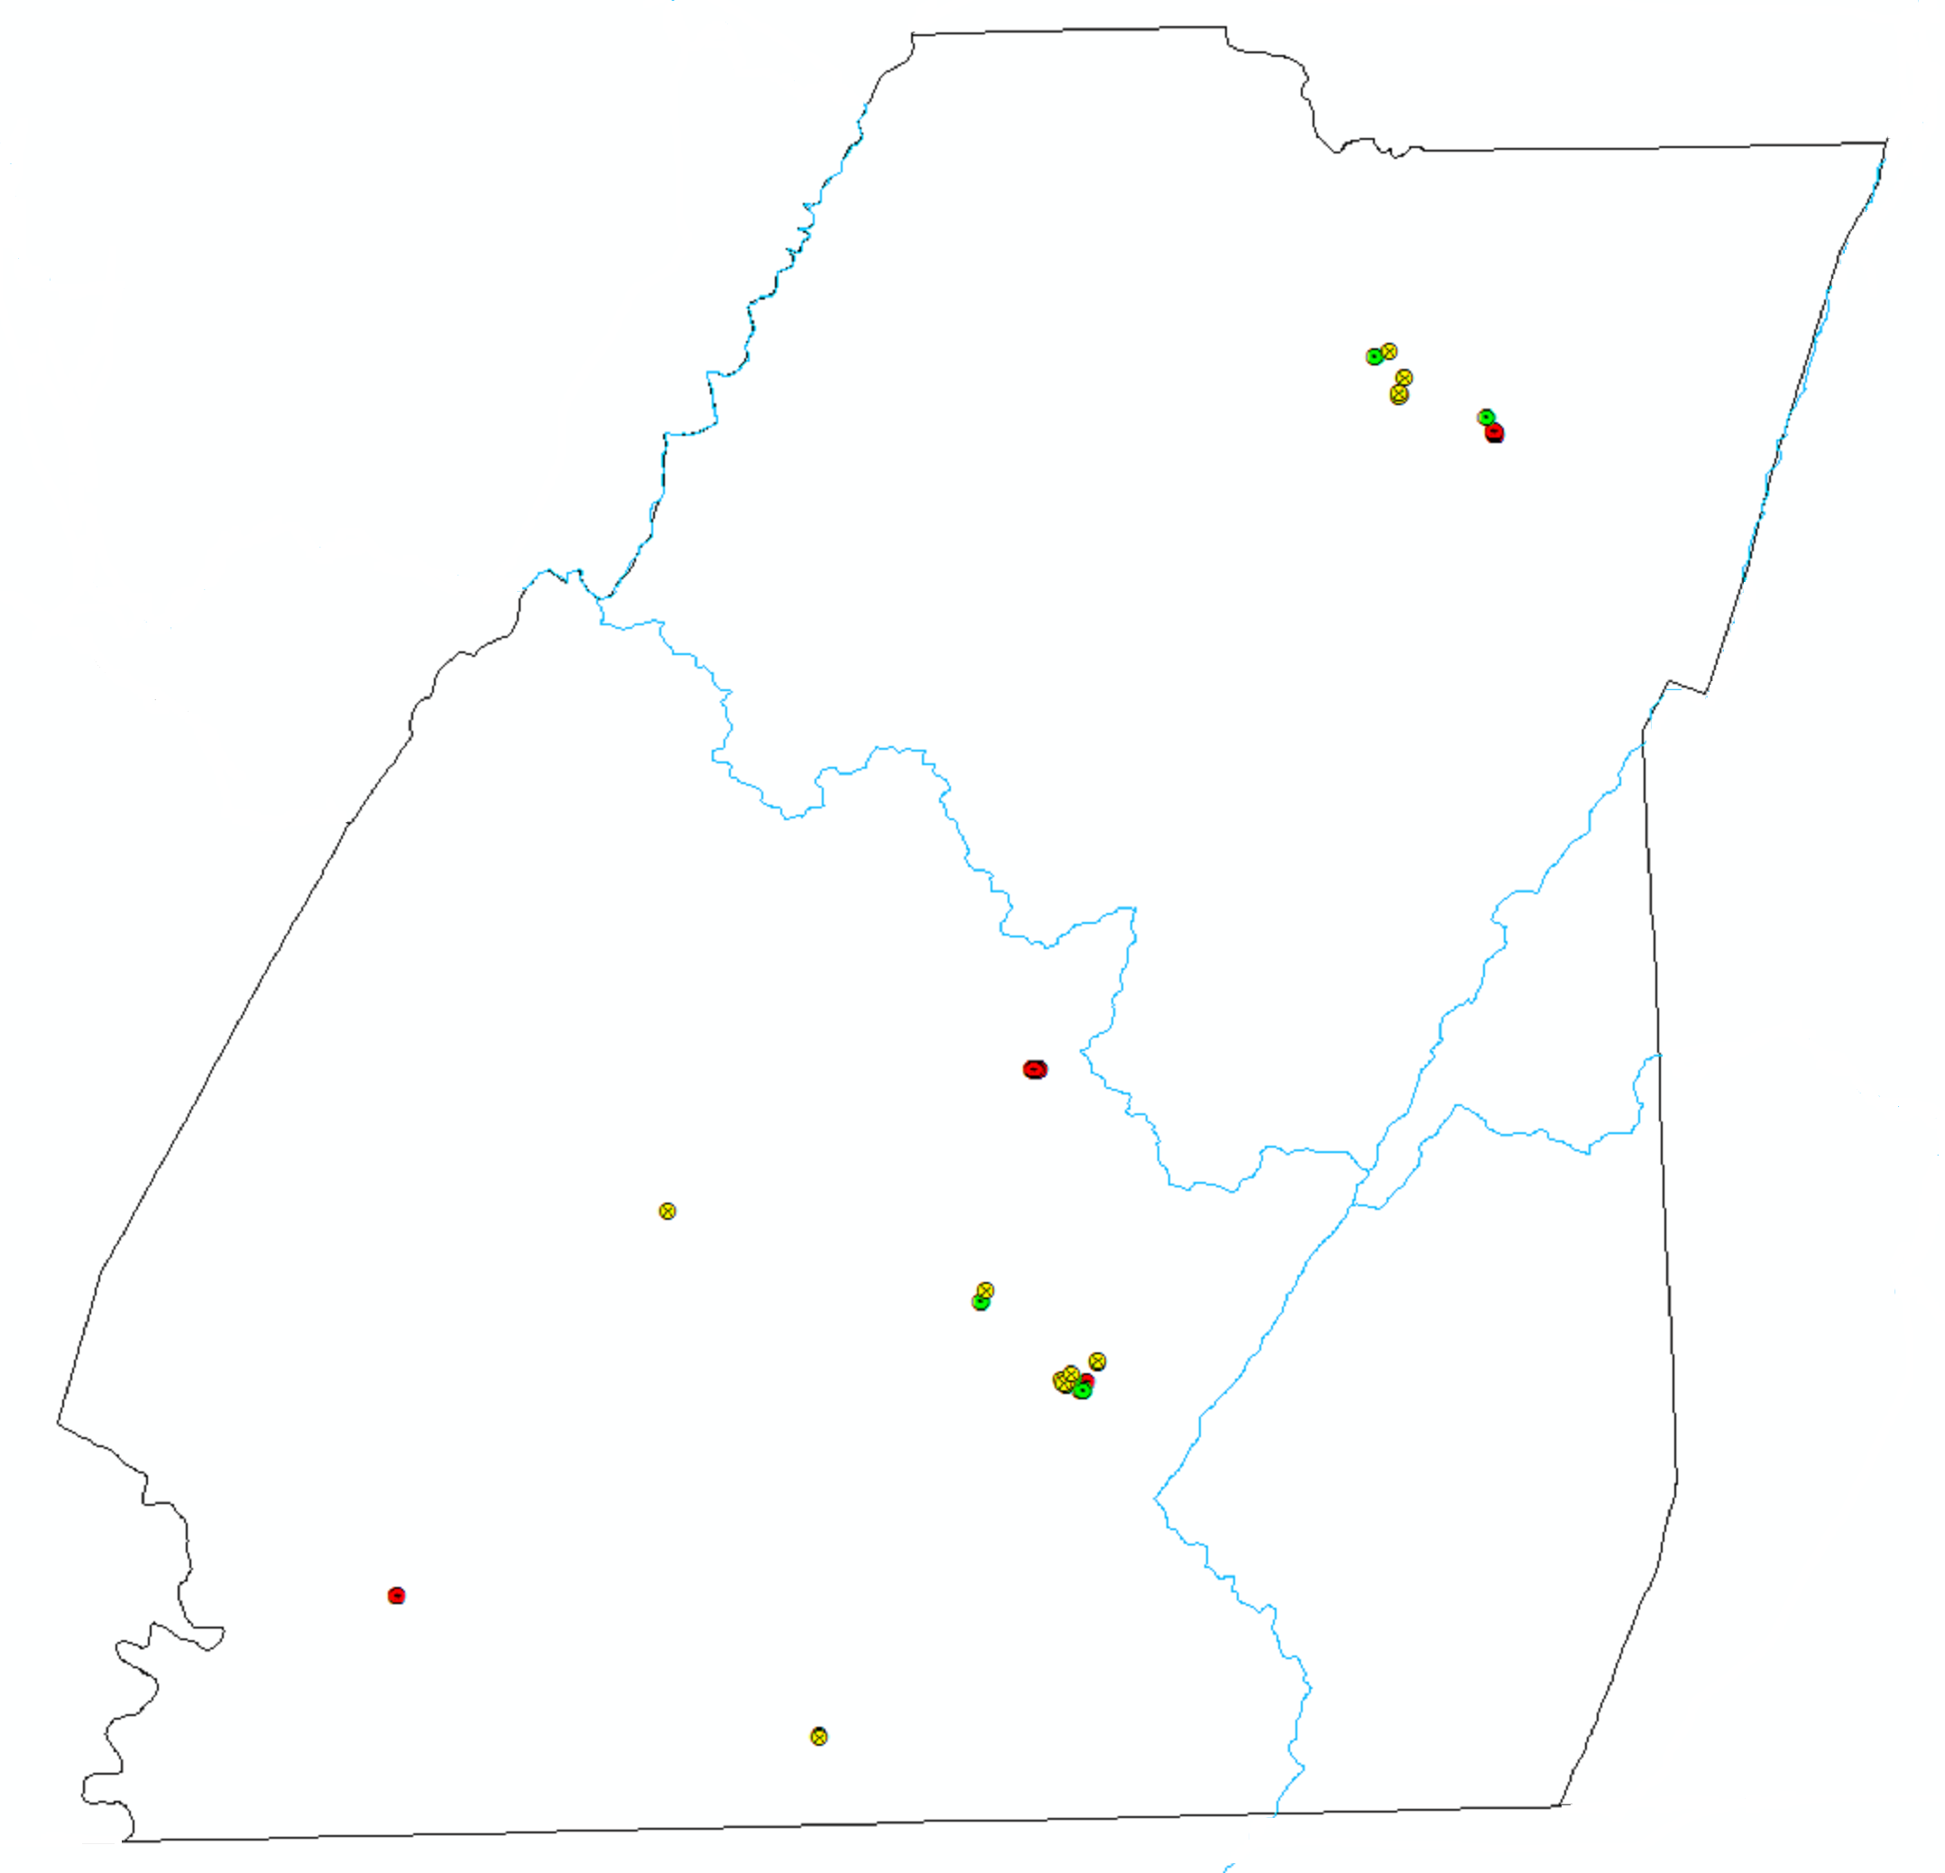
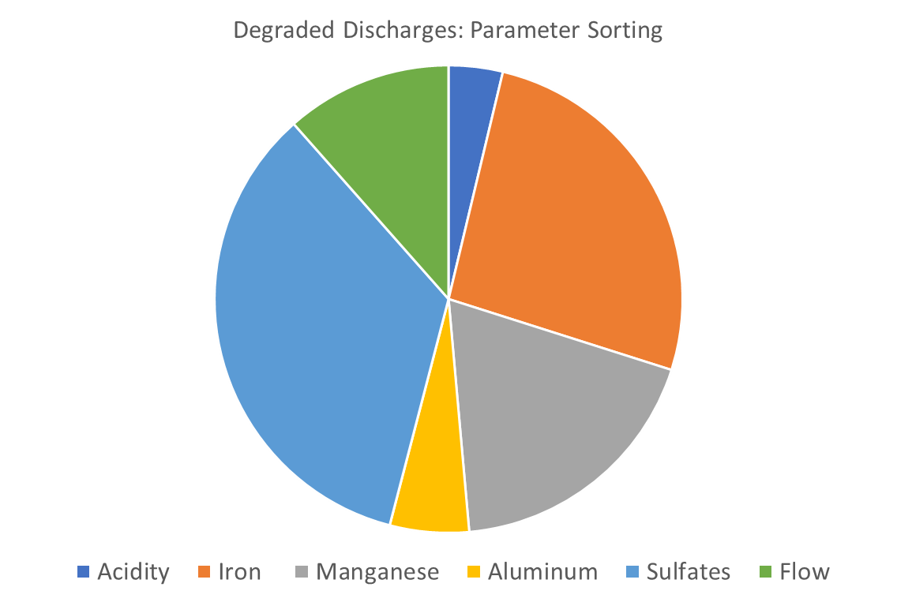
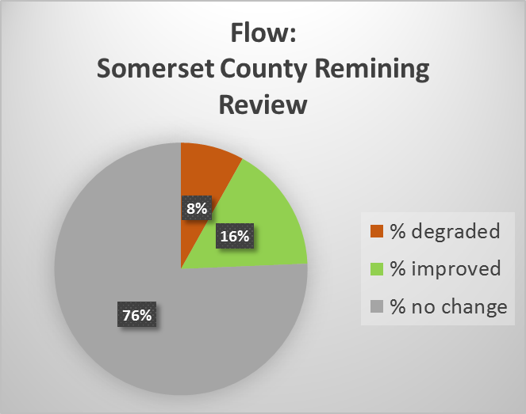
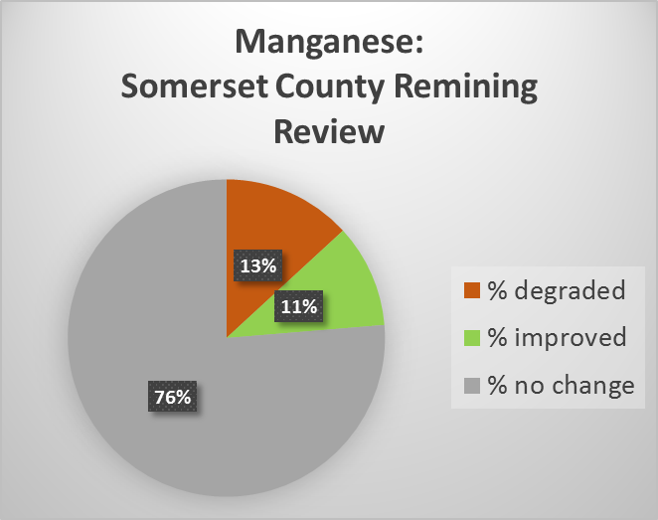
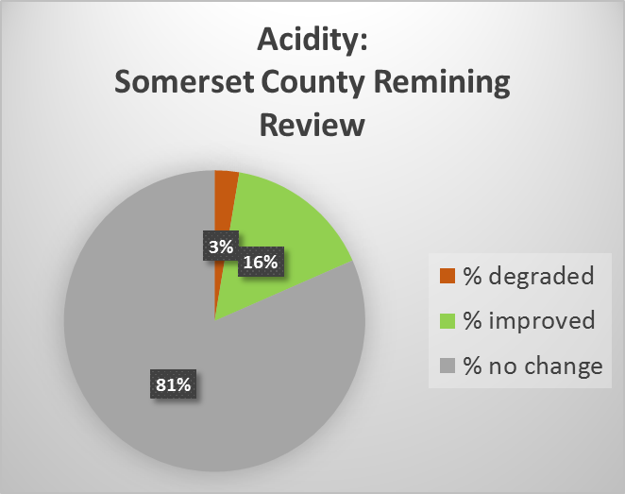
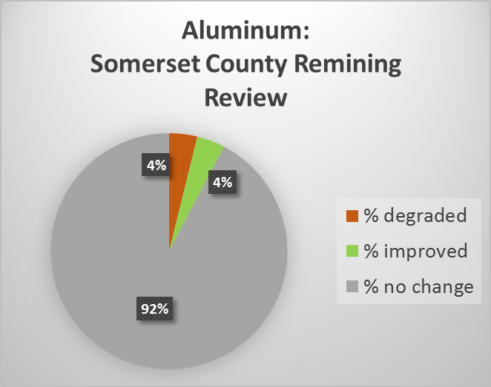
Remining Review: Somerset County
SOMERSET
Somerset Co. Remining Statistics
Statistics by Discharge
100% | 55 | discharges | within | 11 | permits
31% | 17 | discharges eliminated by remining
18.18% | 10 | discharges degraded for at least one parameter
16.36% | 9 | discharges indiacte loading reductionwith no degradation
35% | 19 | discharges indicate no significant change for ay parameter
Statistics by Parameter for post-remining discharges
 | # points | # degraded | % degraded | # improved | % improved | # no change | % no change
Acidity | 38 | 1 | 2.63% | 6 | 15.79% | 31 | 81.58%
Iron | 38 | 7 | 18.42% | 2 | 5.26% | 29 | 76.32%
Manganese | 38 | 5 | 13.16% | 4 | 10.53% | 29 | 76.32%
Aluminum | 26 | 1 | 3.85% | 1 | 3.85% | 24 | 92.31%
Sulfates | 33 | 8 | 24.24% | 4 | 12.12% | 21 | 63.64%
Flow | 37 | 3 | 8.11% | 6 | 16.22% | 28 | 75.68%

Slide 18
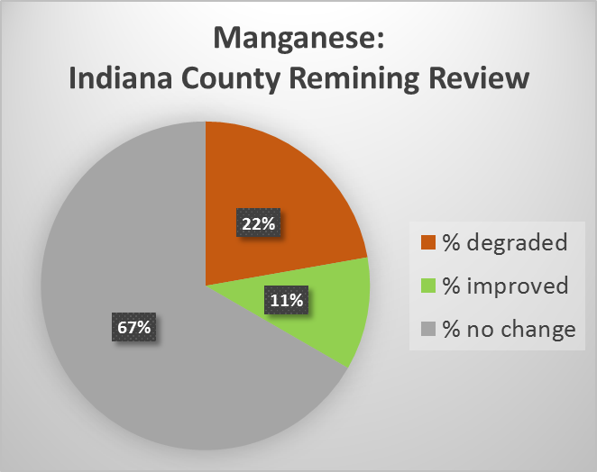
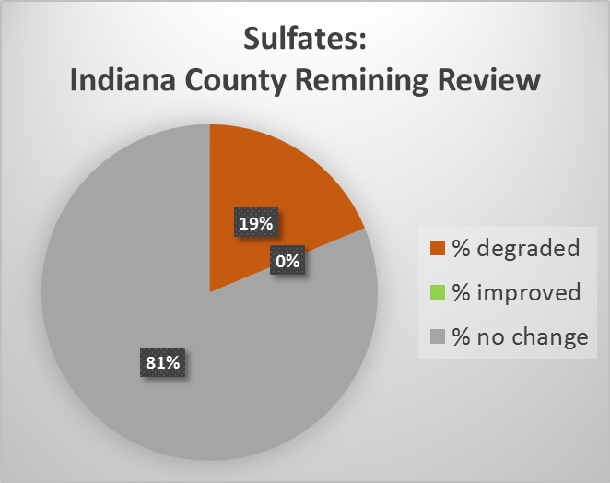
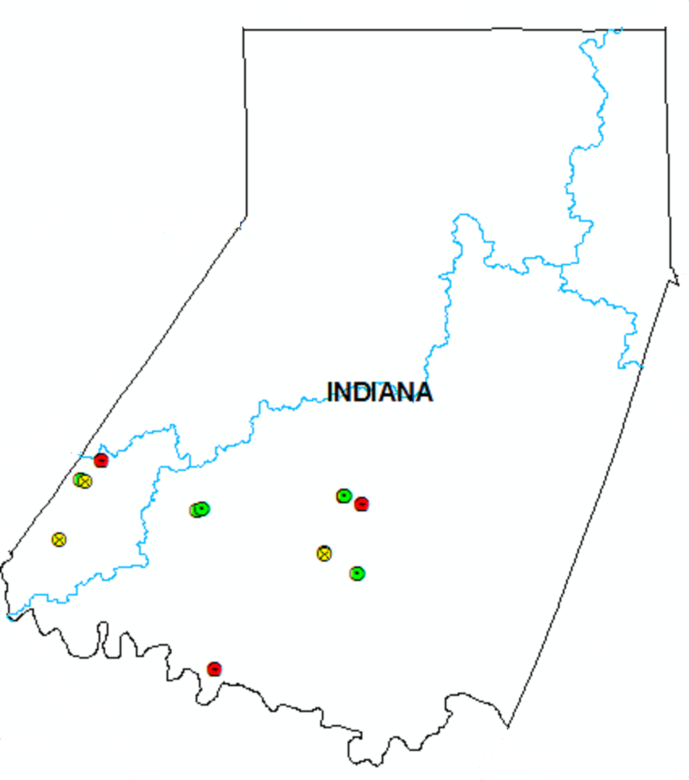
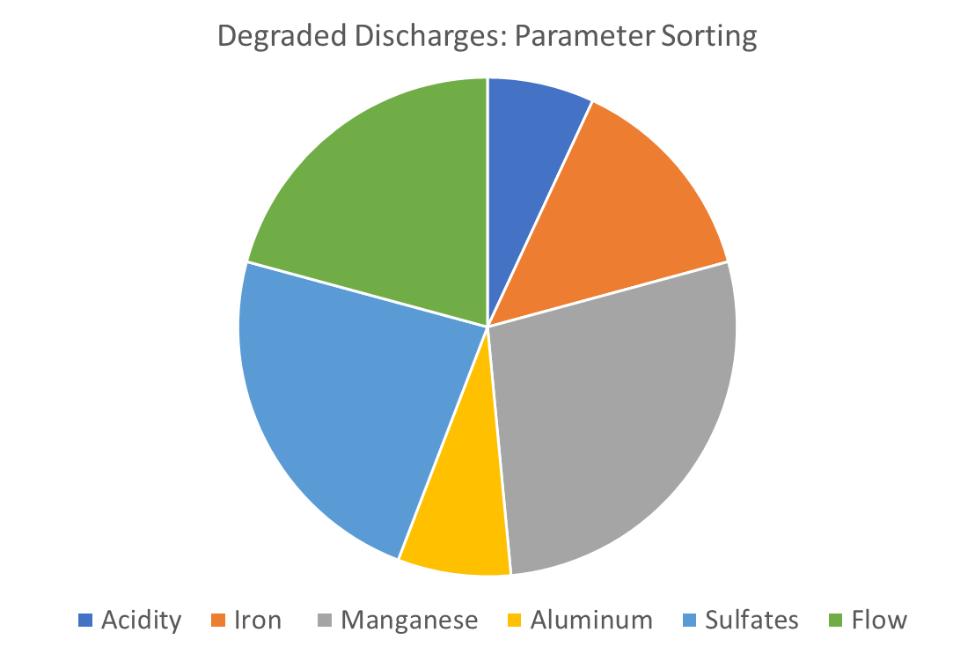
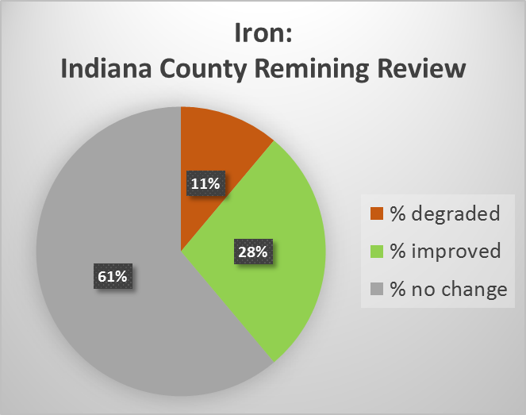
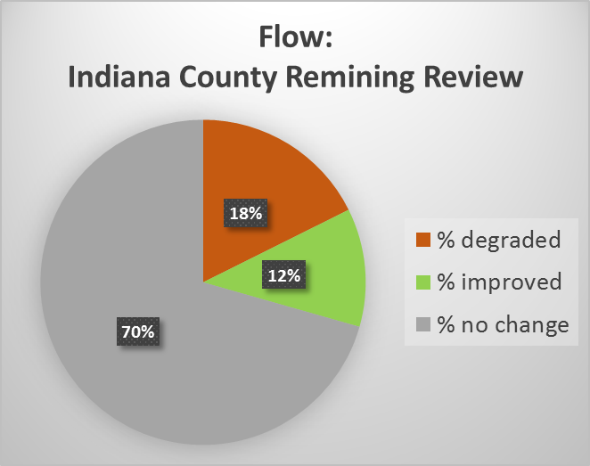
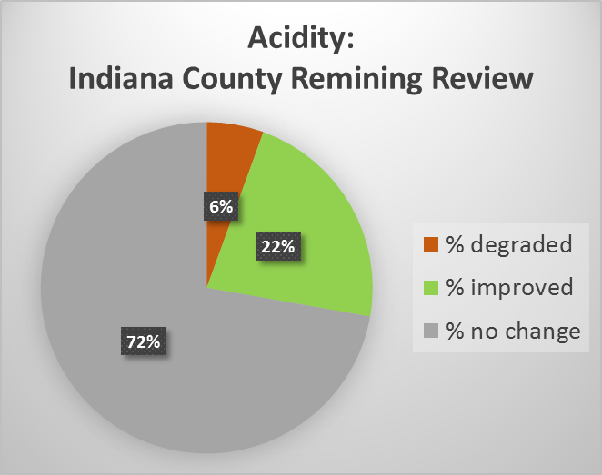
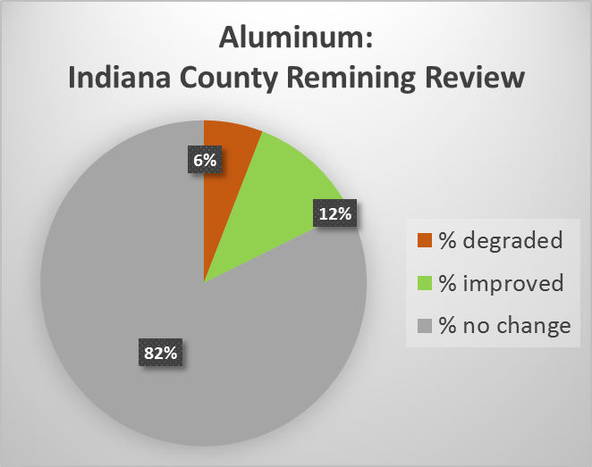
Remining Review: Indiana County
Indiana Co. Remining Statistics
Statistics by Discharge
100% | 22 | discharges | within | 8 | permits
18% | 4 | discharges eliminated by remining
22.73% | 5 | discharges degraded for at least one parameter
22.73% | 5 | discharges indiacte loading reductionwith no degradation
36% | 8 | discharges indicate no significant change for ay parameter
Statistics by Parameter for post-remining discharges
 | # points | # degraded | % degraded | # improved | % improved | # no change | % no change
Acidity | 18 | 1 | 5.56% | 4 | 22.22% | 13 | 72.22%
Iron | 18 | 2 | 11.11% | 5 | 27.78% | 11 | 61.11%
Manganese | 18 | 4 | 22.22% | 2 | 11.11% | 12 | 66.67%
Aluminum | 17 | 1 | 5.88% | 2 | 11.76% | 14 | 82.35%
Sulfates | 16 | 3 | 18.75% | 0 | 0.00% | 13 | 81.25%
Flow | 18 | 3 | 16.67% | 2 | 11.11% | 12 | 66.67%

Slide 19
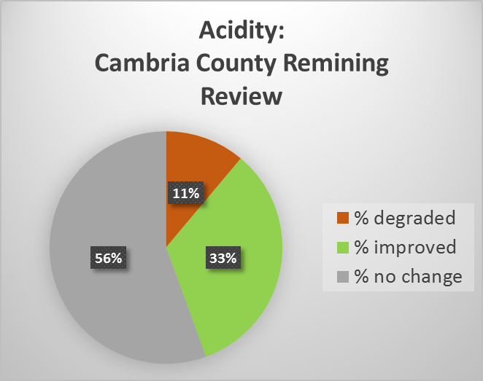
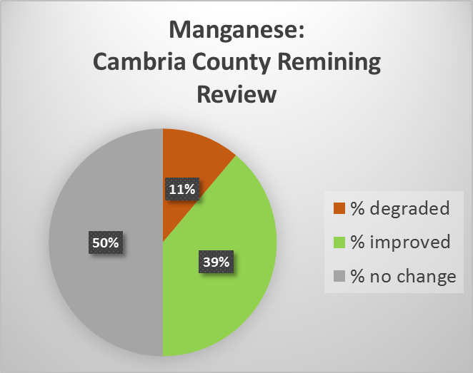
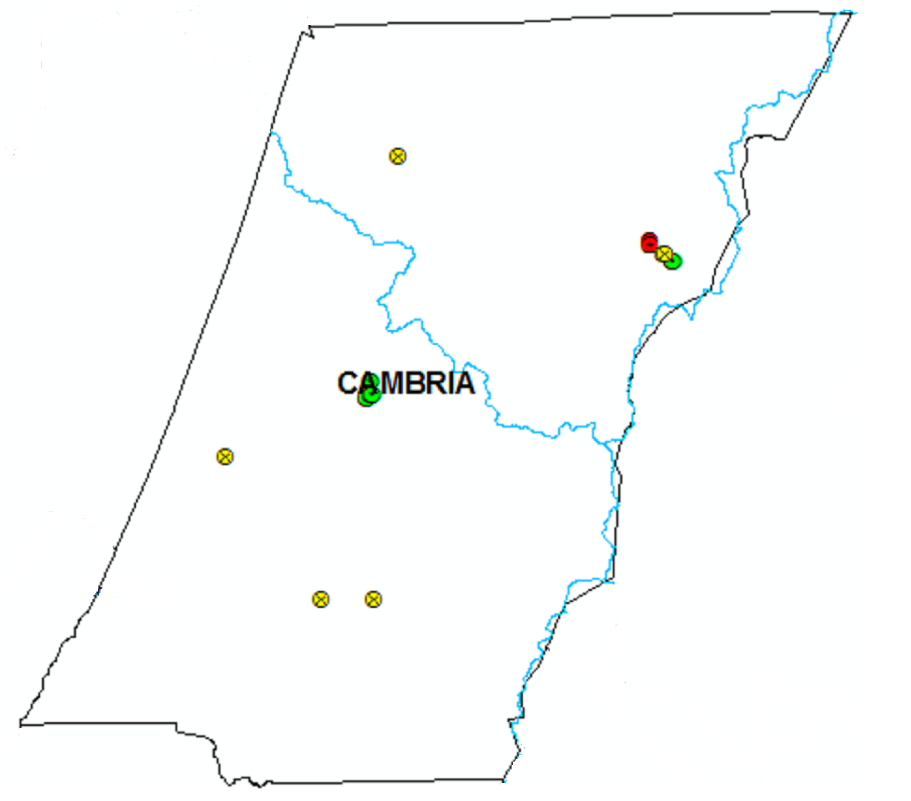
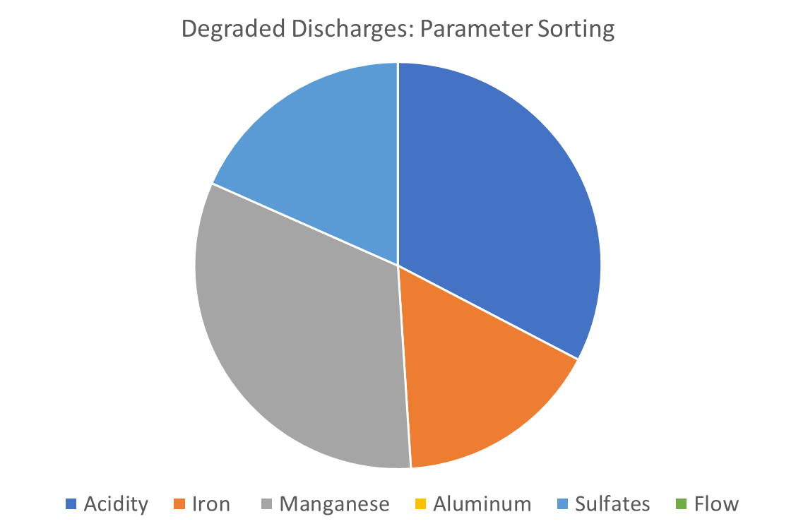
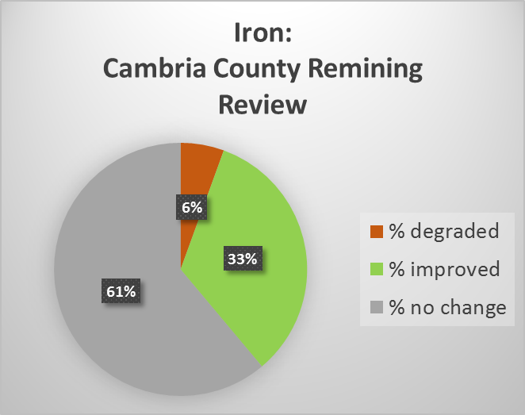
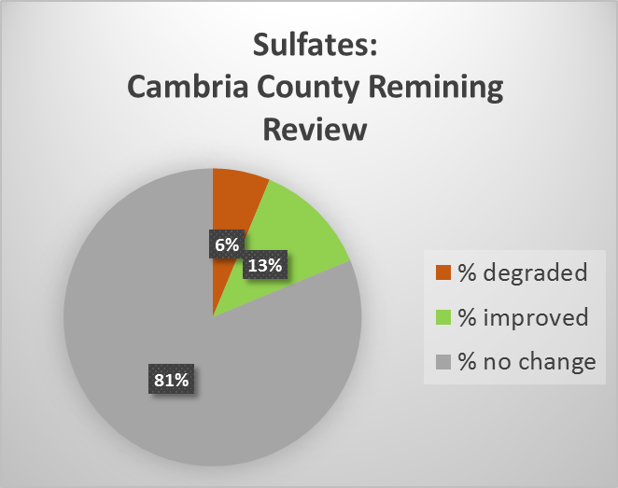
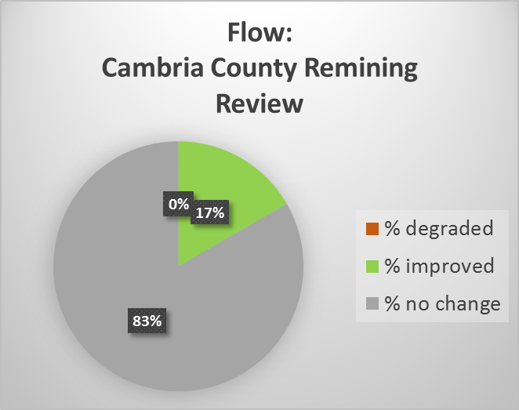
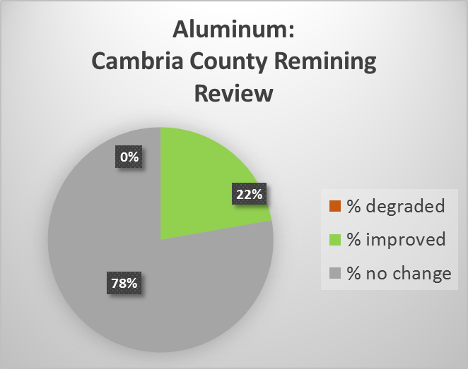
Remining Review: Cambria County
Cambria County Remining Statistics
Statistics by Discharge
100% | 24 | discharges | within | 6 | permits
25% | 6 | discharges eliminated by remining
12.50% | 3 | discharges degraded for at least one parameter
33.33% | 8 | discharges indiacte loading reductionwith no degradation
29% | 7 | discharges indicate no significant change for ay parameter
Statistics by Parameter for post-remining discharges
 | # points | # degraded | % degraded | # improved | % improved | # no change | % no change
Acidity | 18 | 2 | 11.11% | 6 | 33.33% | 10 | 55.56%
Iron | 18 | 1 | 5.56% | 6 | 33.33% | 11 | 61.11%
Manganese | 18 | 2 | 11.11% | 7 | 38.89% | 9 | 50.00%
Aluminum | 18 | 0 | 0.00% | 4 | 22.22% | 14 | 77.78%
Sulfates | 16 | 1 | 6.25% | 2 | 12.50% | 13 | 81.25%
Flow | 18 | 0 | 0.00% | 3 | 16.67% | 15 | 83.33%

Slide 20
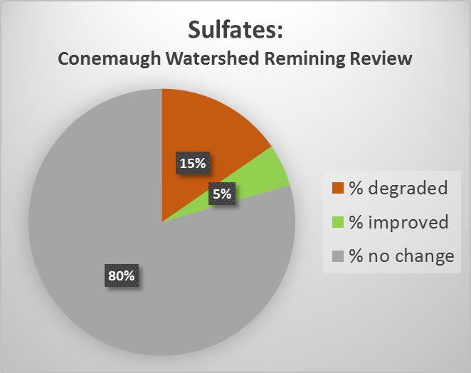
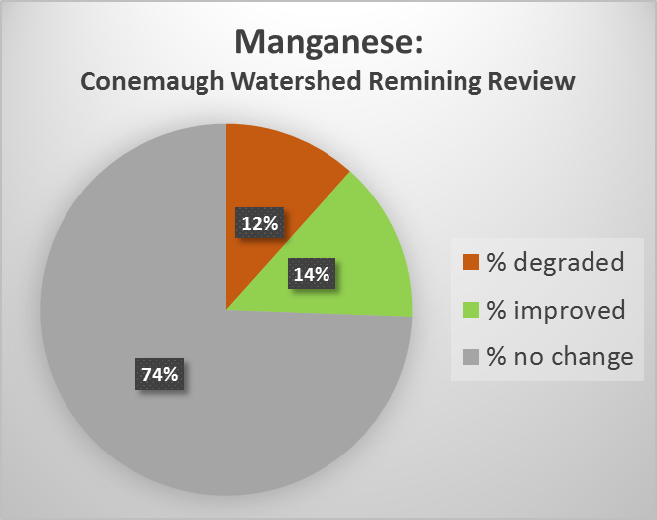
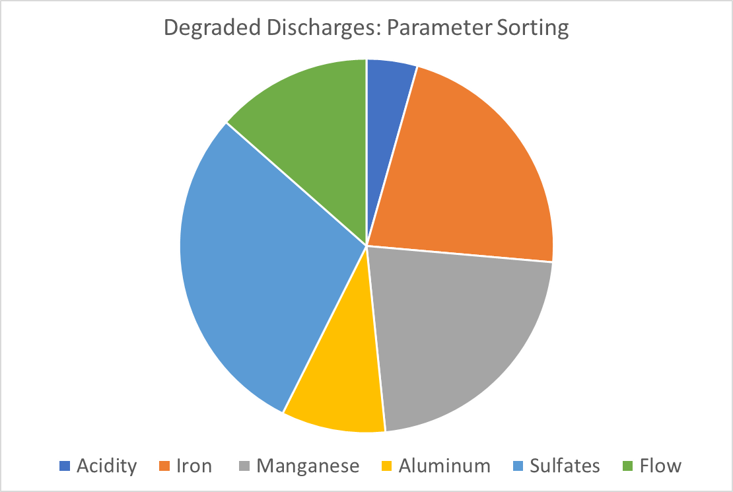
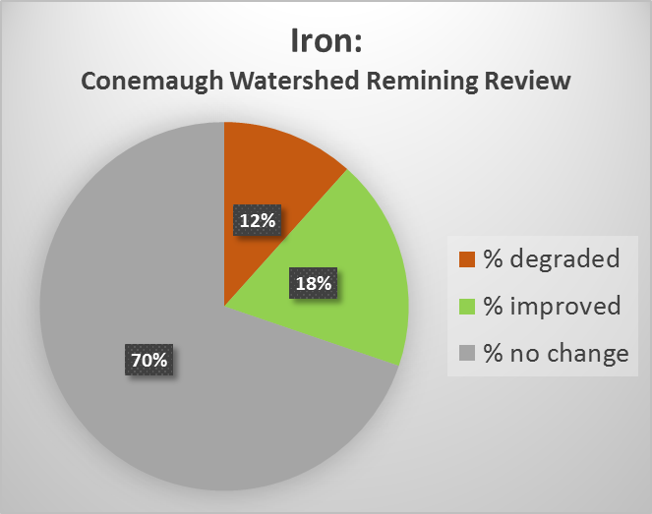
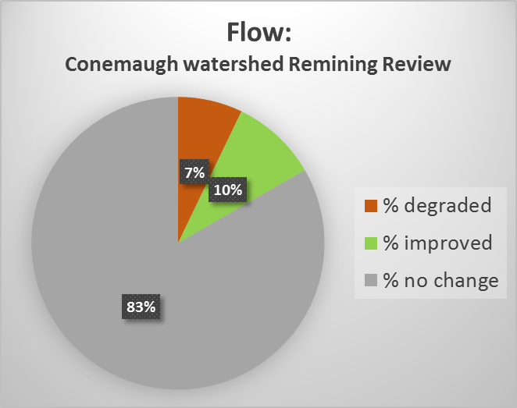
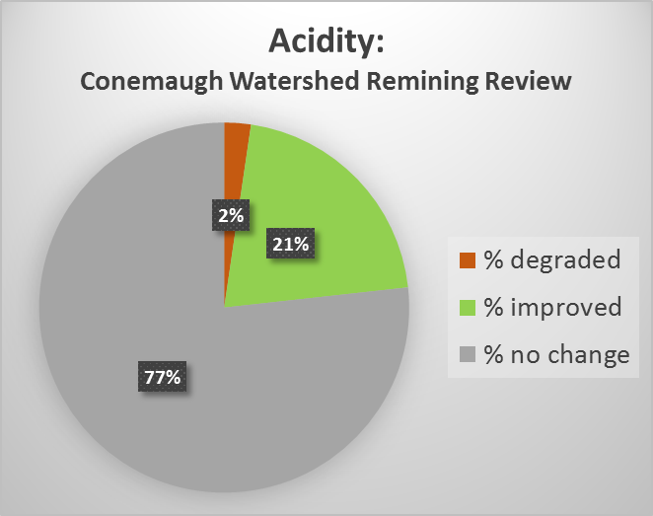
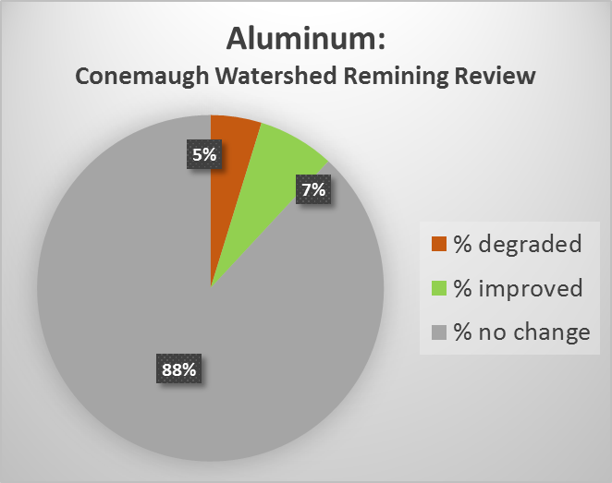
Remining Review: Conemaugh Watershed
Conemaugh Watershed Remining Statistics
100% | 55 | discharges | within | 11 | permits
22% | 12 | discharges eliminated by remining
18.18% | 10 | discharges degraded for at least one parameter
20.00% | 11 | discharges indicate loading reduction for at least one parameter
40% | 22 | discharges indicate no significant change for ay parameter
Statistics by Parameter for post-remining discharges
 | # points | # degraded | % degraded | # improved | % improved | # no change | % no change
Acidity | 43 | 1 | 2.33% | 9 | 20.93% | 33 | 76.74%
Iron | 43 | 5 | 11.63% | 8 | 18.60% | 30 | 69.77%
Manganese | 43 | 5 | 11.63% | 6 | 13.95% | 32 | 74.42%
Aluminum | 42 | 2 | 4.76% | 3 | 7.14% | 37 | 88.10%
Sulfates | 39 | 6 | 15.38% | 2 | 5.13% | 31 | 79.49%
Flow | 42 | 3 | 7.14% | 4 | 9.52% | 35 | 83.33%

Slide 21
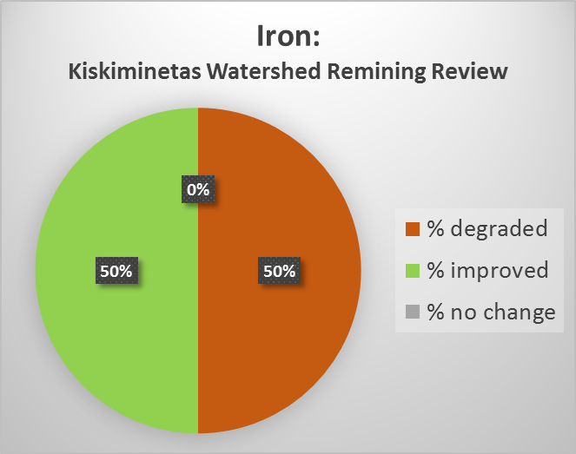
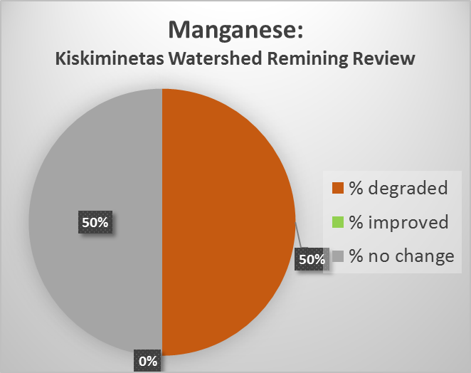
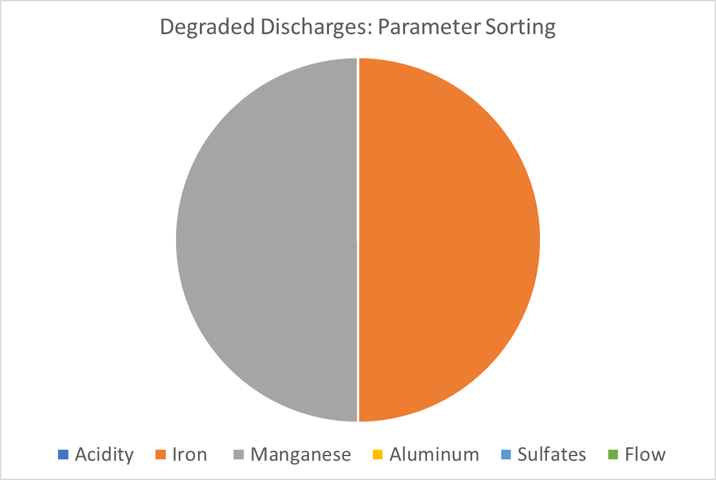
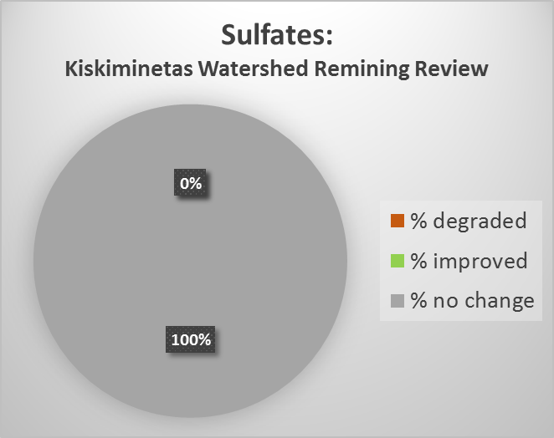
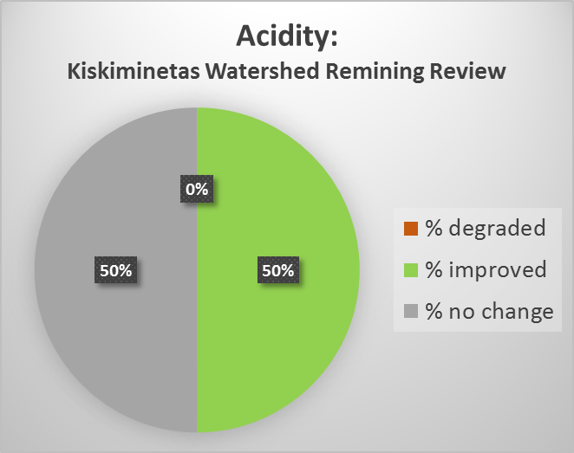
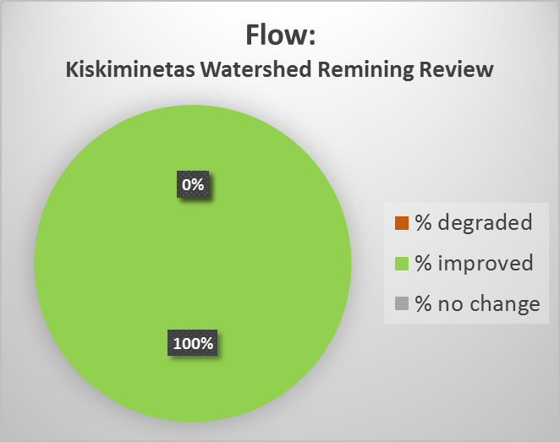
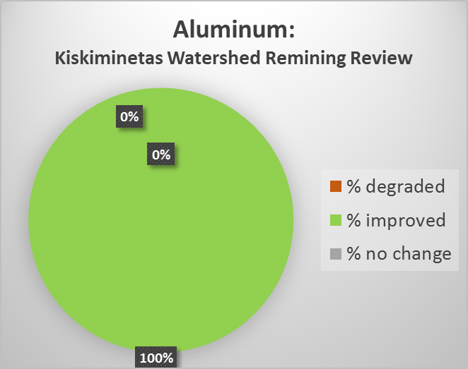
Remining Review: Kiskiminetas Watershed
Kiskiminetas Watershed Remining Statistics
100% | 4 | discharges | within | 3 | permits
50% | 2 | discharges eliminated by remining
25.00% | 1 | discharges degraded for at least one parameter
25.00% | 1 | discharges indicate loading reduction for at least one parameter
0% | 0 | discharges indicate no significant change for ay parameter
Statistics by Parameter for post-remining discharges
 | # points | # degraded | % degraded | # improved | % improved | # no change | % no change
Acidity | 2 | 0 | 0.00% | 1 | 50.00% | 1 | 50.00%
Iron | 2 | 1 | 50.00% | 1 | 50.00% | 0 | 0.00%
Manganese | 2 | 1 | 50.00% | 0 | 0.00% | 1 | 50.00%
Aluminum | 1 | 0 | 0.00% | 1 | 100.00% | 0 | 0.00%
Sulfates | 1 | 0 | 0.00% | 0 | 0.00% | 1 | 100.00%
Flow | 1 | 0 | 0.00% | 1 | 100.00% | 0 | 0.00%

Slide 22








Remining Review: Kiskiminetas-Conemaugh Watershed
Kiski-Conemaugh Watershed Remining Statistics
100% | 59 | discharges | within | 14 | permits
24% | 14 | discharges eliminated by remining
18.64% | 11 | discharges degraded for at least one parameter
20.34% | 12 | discharges indicate loading reduction for at least one parameter
37% | 22 | discharges indicate no significant change for ay parameter
Statistics by Parameter for post-remining discharges
 | # points | # degraded | % degraded | # improved | % improved | # no change | % no change
Acidity | 45 | 1 | 2% | 10 | 22% | 34 | 76%
Iron | 45 | 6 | 13% | 9 | 20% | 30 | 67%
Manganese | 45 | 6 | 13% | 6 | 13% | 33 | 73%
Aluminum | 43 | 2 | 5% | 4 | 9% | 37 | 86%
Sulfates | 40 | 6 | 15% | 2 | 5% | 32 | 80%
Flow | 43 | 3 | 7% | 5 | 12% | 35 | 81%

Slide 23








Remining Review: Youghiogheny-Casselman Watershed
Youghiogheny Watershed Remining Statistics
100% | 23 | discharges | within | 7 | permits
39% | 9 | discharges eliminated by remining
17.39% | 4 | discharges degraded for at least one parameter
21.74% | 5 | discharges indiacte loading reductionwith no degradation
22% | 5 | discharges indicate no significant change for ay parameter
Statistics by Parameter for post-remining discharges
 | # points | # degraded | % degraded | # improved | % improved | # no change | % no change
Acidity | 14 | 1 | 7.14% | 4 | 28.57% | 9 | 64.29%
Iron | 14 | 1 | 7.14% | 0 | 0.00% | 13 | 92.86%
Manganese | 14 | 4 | 28.57% | 2 | 14.29% | 8 | 57.14%
Aluminum | 7 | 0 | 0.00% | 1 | 14.29% | 6 | 85.71%
Sulfates | 8 | 2 | 25.00% | 1 | 12.50% | 5 | 62.50%
Flow | 14 | 2 | 14.29% | 4 | 28.57% | 8 | 57.14%

Slide 24








Remining Review: Upper West Branch Susquehanna Watershed
Upper West Branch Susquehanna Watershed Remining Statistics
100% | 14 | discharges | within | 2 | permits
21% | 3 | discharges eliminated by remining
14.29% | 2 | discharges degraded for at least one parameter
28.57% | 4 | discharges indiacte loading reductionwith no degradation
29% | 4 | discharges indicate no significant change for ay parameter
Statistics by Parameter for post-remining discharges
 | # points | # degraded | % degraded | # improved | % improved | # no change | % no change
Acidity | 11 | 2 | 18.18% | 1 | 9.09% | 8 | 72.73%
Iron | 11 | 1 | 9.09% | 2 | 18.18% | 8 | 72.73%
Manganese | 11 | 1 | 9.09% | 4 | 36.36% | 6 | 54.55%
Aluminum | 11 | 0 | 0.00% | 2 | 18.18% | 9 | 81.82%
Sulfates | 11 | 1 | 9.09% | 1 | 9.09% | 9 | 81.82%
Flow | 11 | 0 | 0.00% | 1 | 9.09% | 10 | 90.91%

Slide 25
2017 Cambria District Remining Review:
Coal Seam Overall Statistics

Slide 26
2017 Cambria District Remining Review:
Comparison to earlier PA DEP studies (Smith et. al 2002)

Slide 27
2017 Cambria District Remining Review:
Comparison to earlier PA DEP studies (Smith et. al 2002)

Slide 28
Ideas for Further Research
Itemize statistics based on remining abatement techniques, for example:
Extend the statistical compilation to individual parameters for each coal seam
Produce some publications that include our conclusions and recommendations
Combine our overall statistics (2017 review) with those of previous studies

Slide 29
Thank You!
Rock Martin, PG
Technical Services Section Chief
Cambria District Mining Office
286 Industrial Park Rd
Ebensburg, PA 15931
martin@pa.gov

