Slide 1
R.T. Vanderbilt Company, Inc. No. 1 and 2 Mines – Reclamation

Slide 2
R.T. Vanderbilt Company, Inc. No. 1 and 2 Mines – Reclamation

Slide 3
R.T. Vanderbilt Company, Inc. No. 1 and 2 Mines – Reclamation

Slide 4
R.T. Vanderbilt Company, Inc. No. 1 and 2 Mines – Reclamation

Slide 5
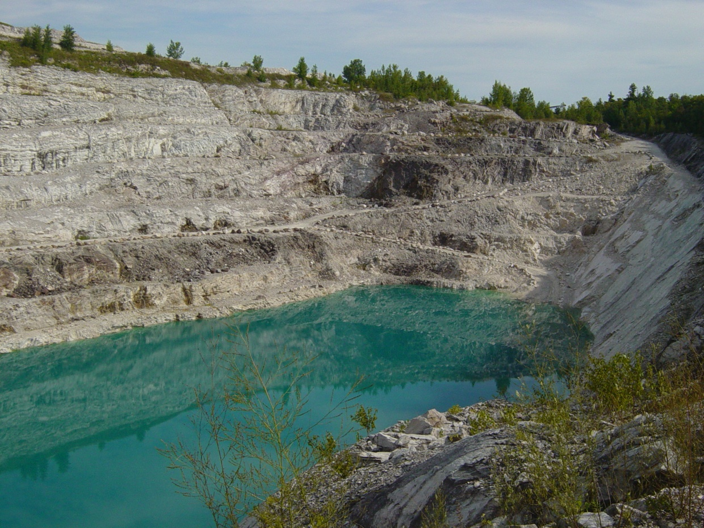
R.T. Vanderbilt Company, Inc. No. 1 and 2 Mines – Reclamation
September 2013
June 2017
2008

Slide 6
R.T. Vanderbilt Company, Inc. No. 1 and 2 Mines – Reclamation

Slide 7
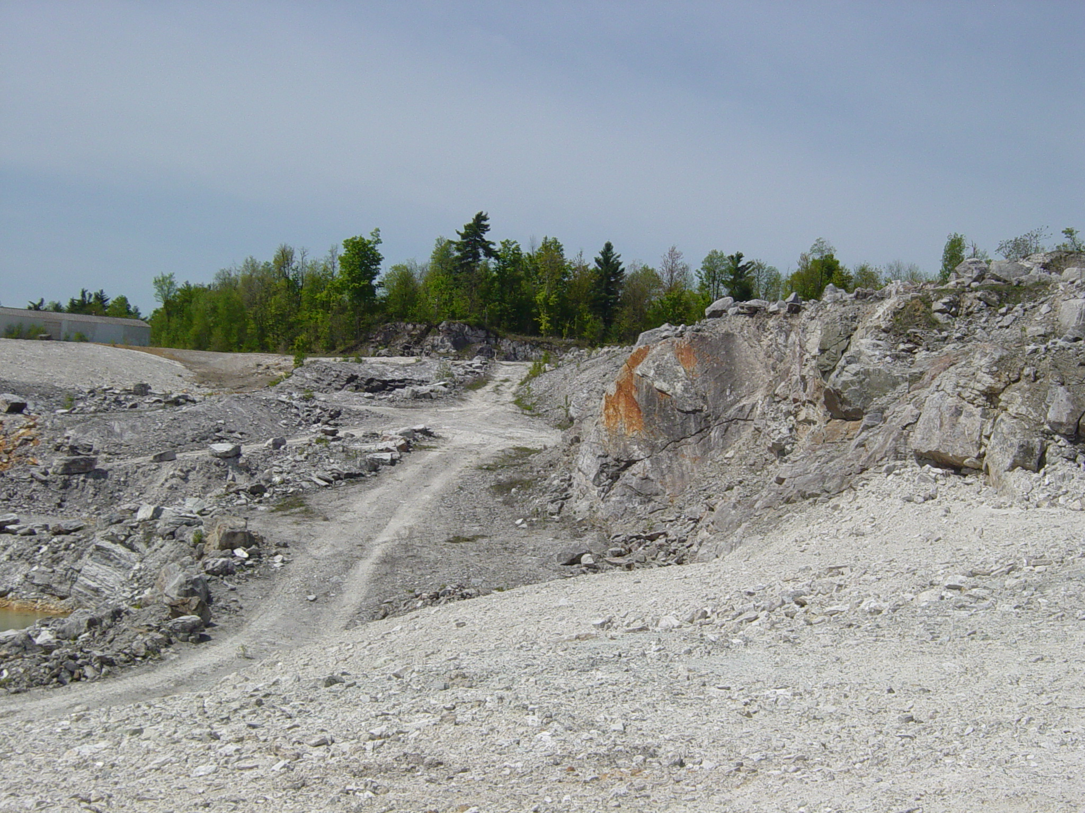
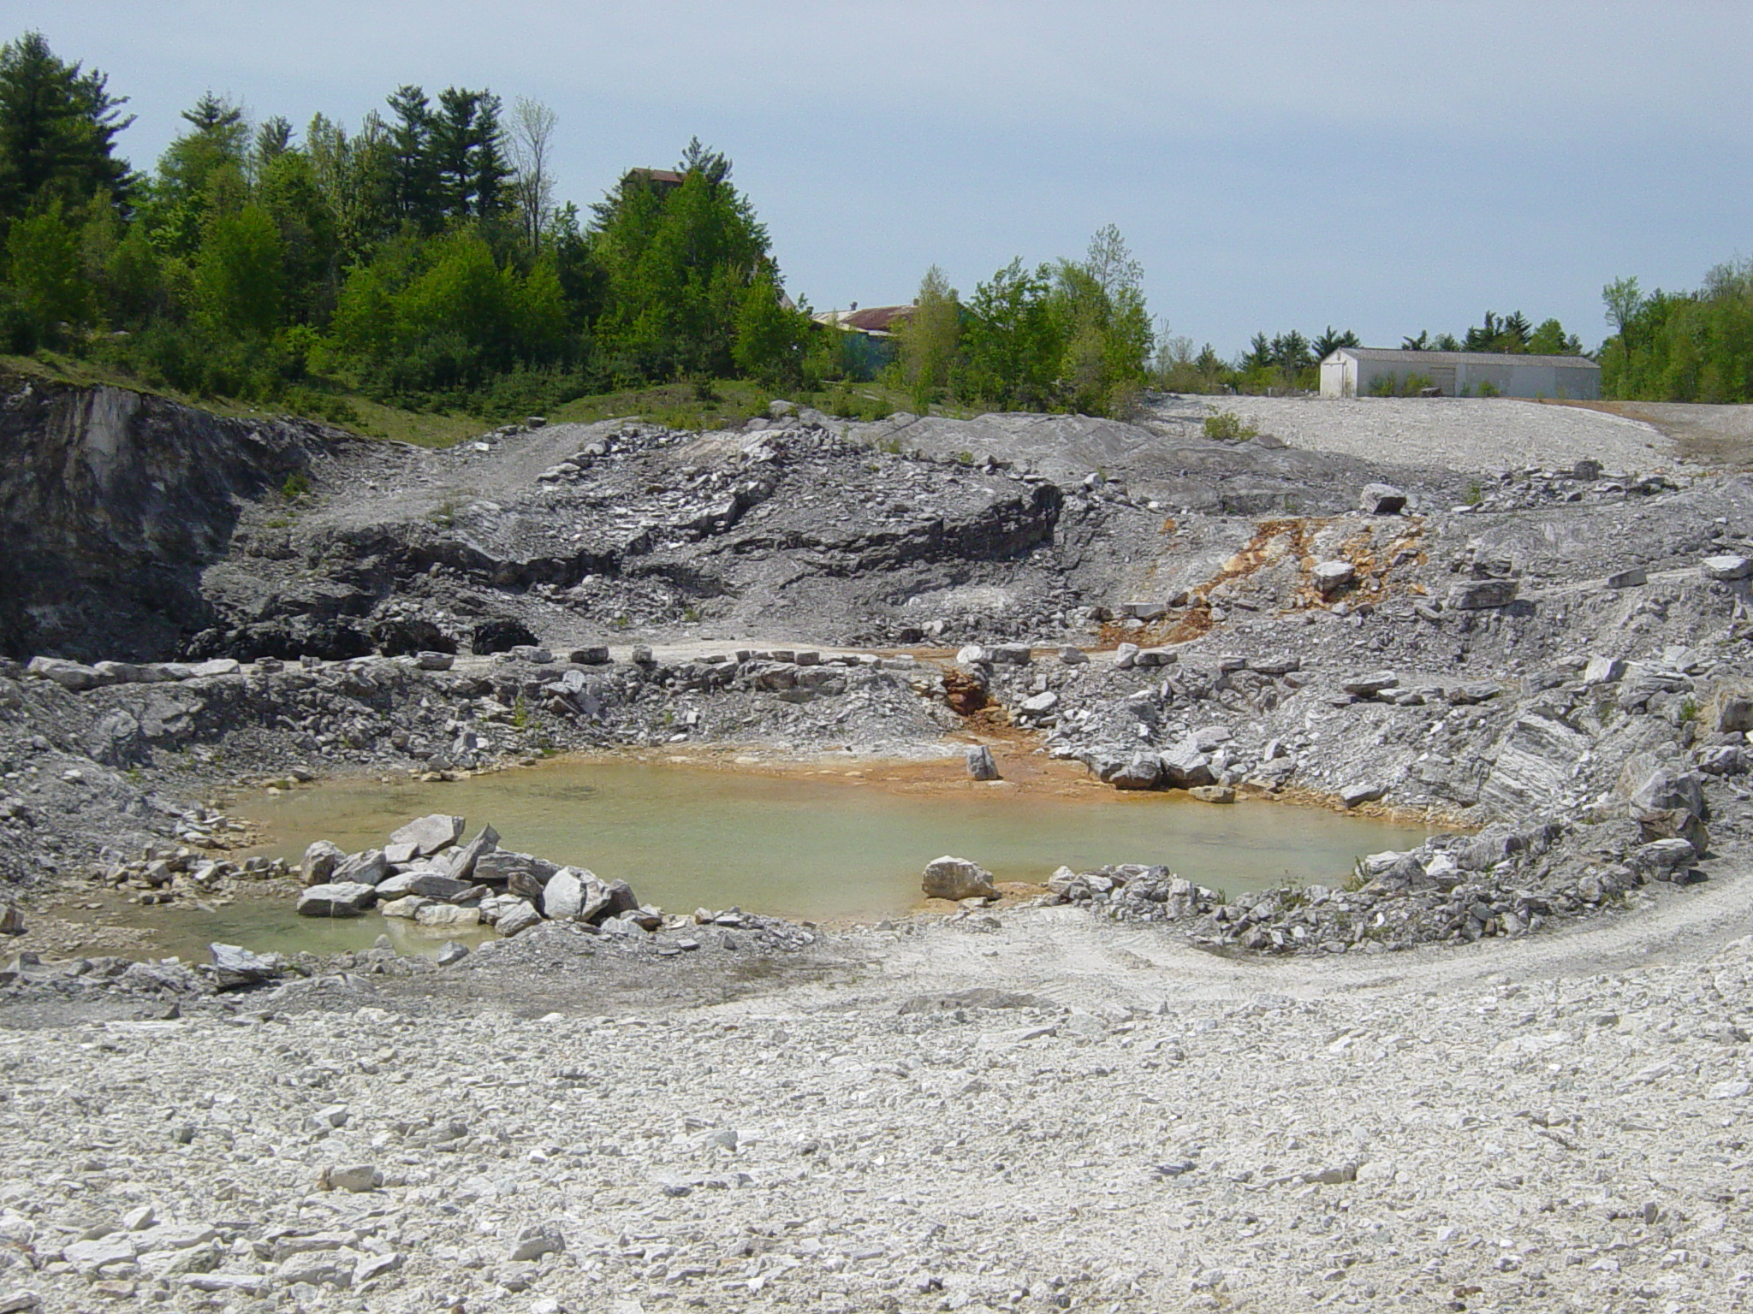
R.T. Vanderbilt Company, Inc. No. 1 and 2 Mines – Reclamation

Slide 8
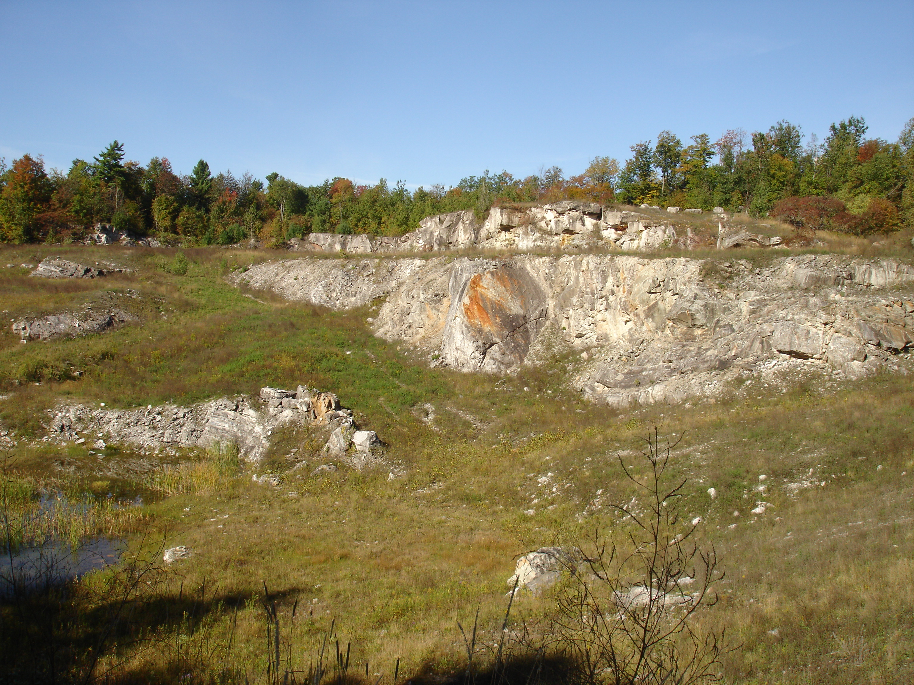
R.T. Vanderbilt Company, Inc. No. 1 and 2 Mines – Reclamation

Slide 9
R.T. Vanderbilt Company, Inc. No. 1 and 2 Mines – Reclamation

Slide 10
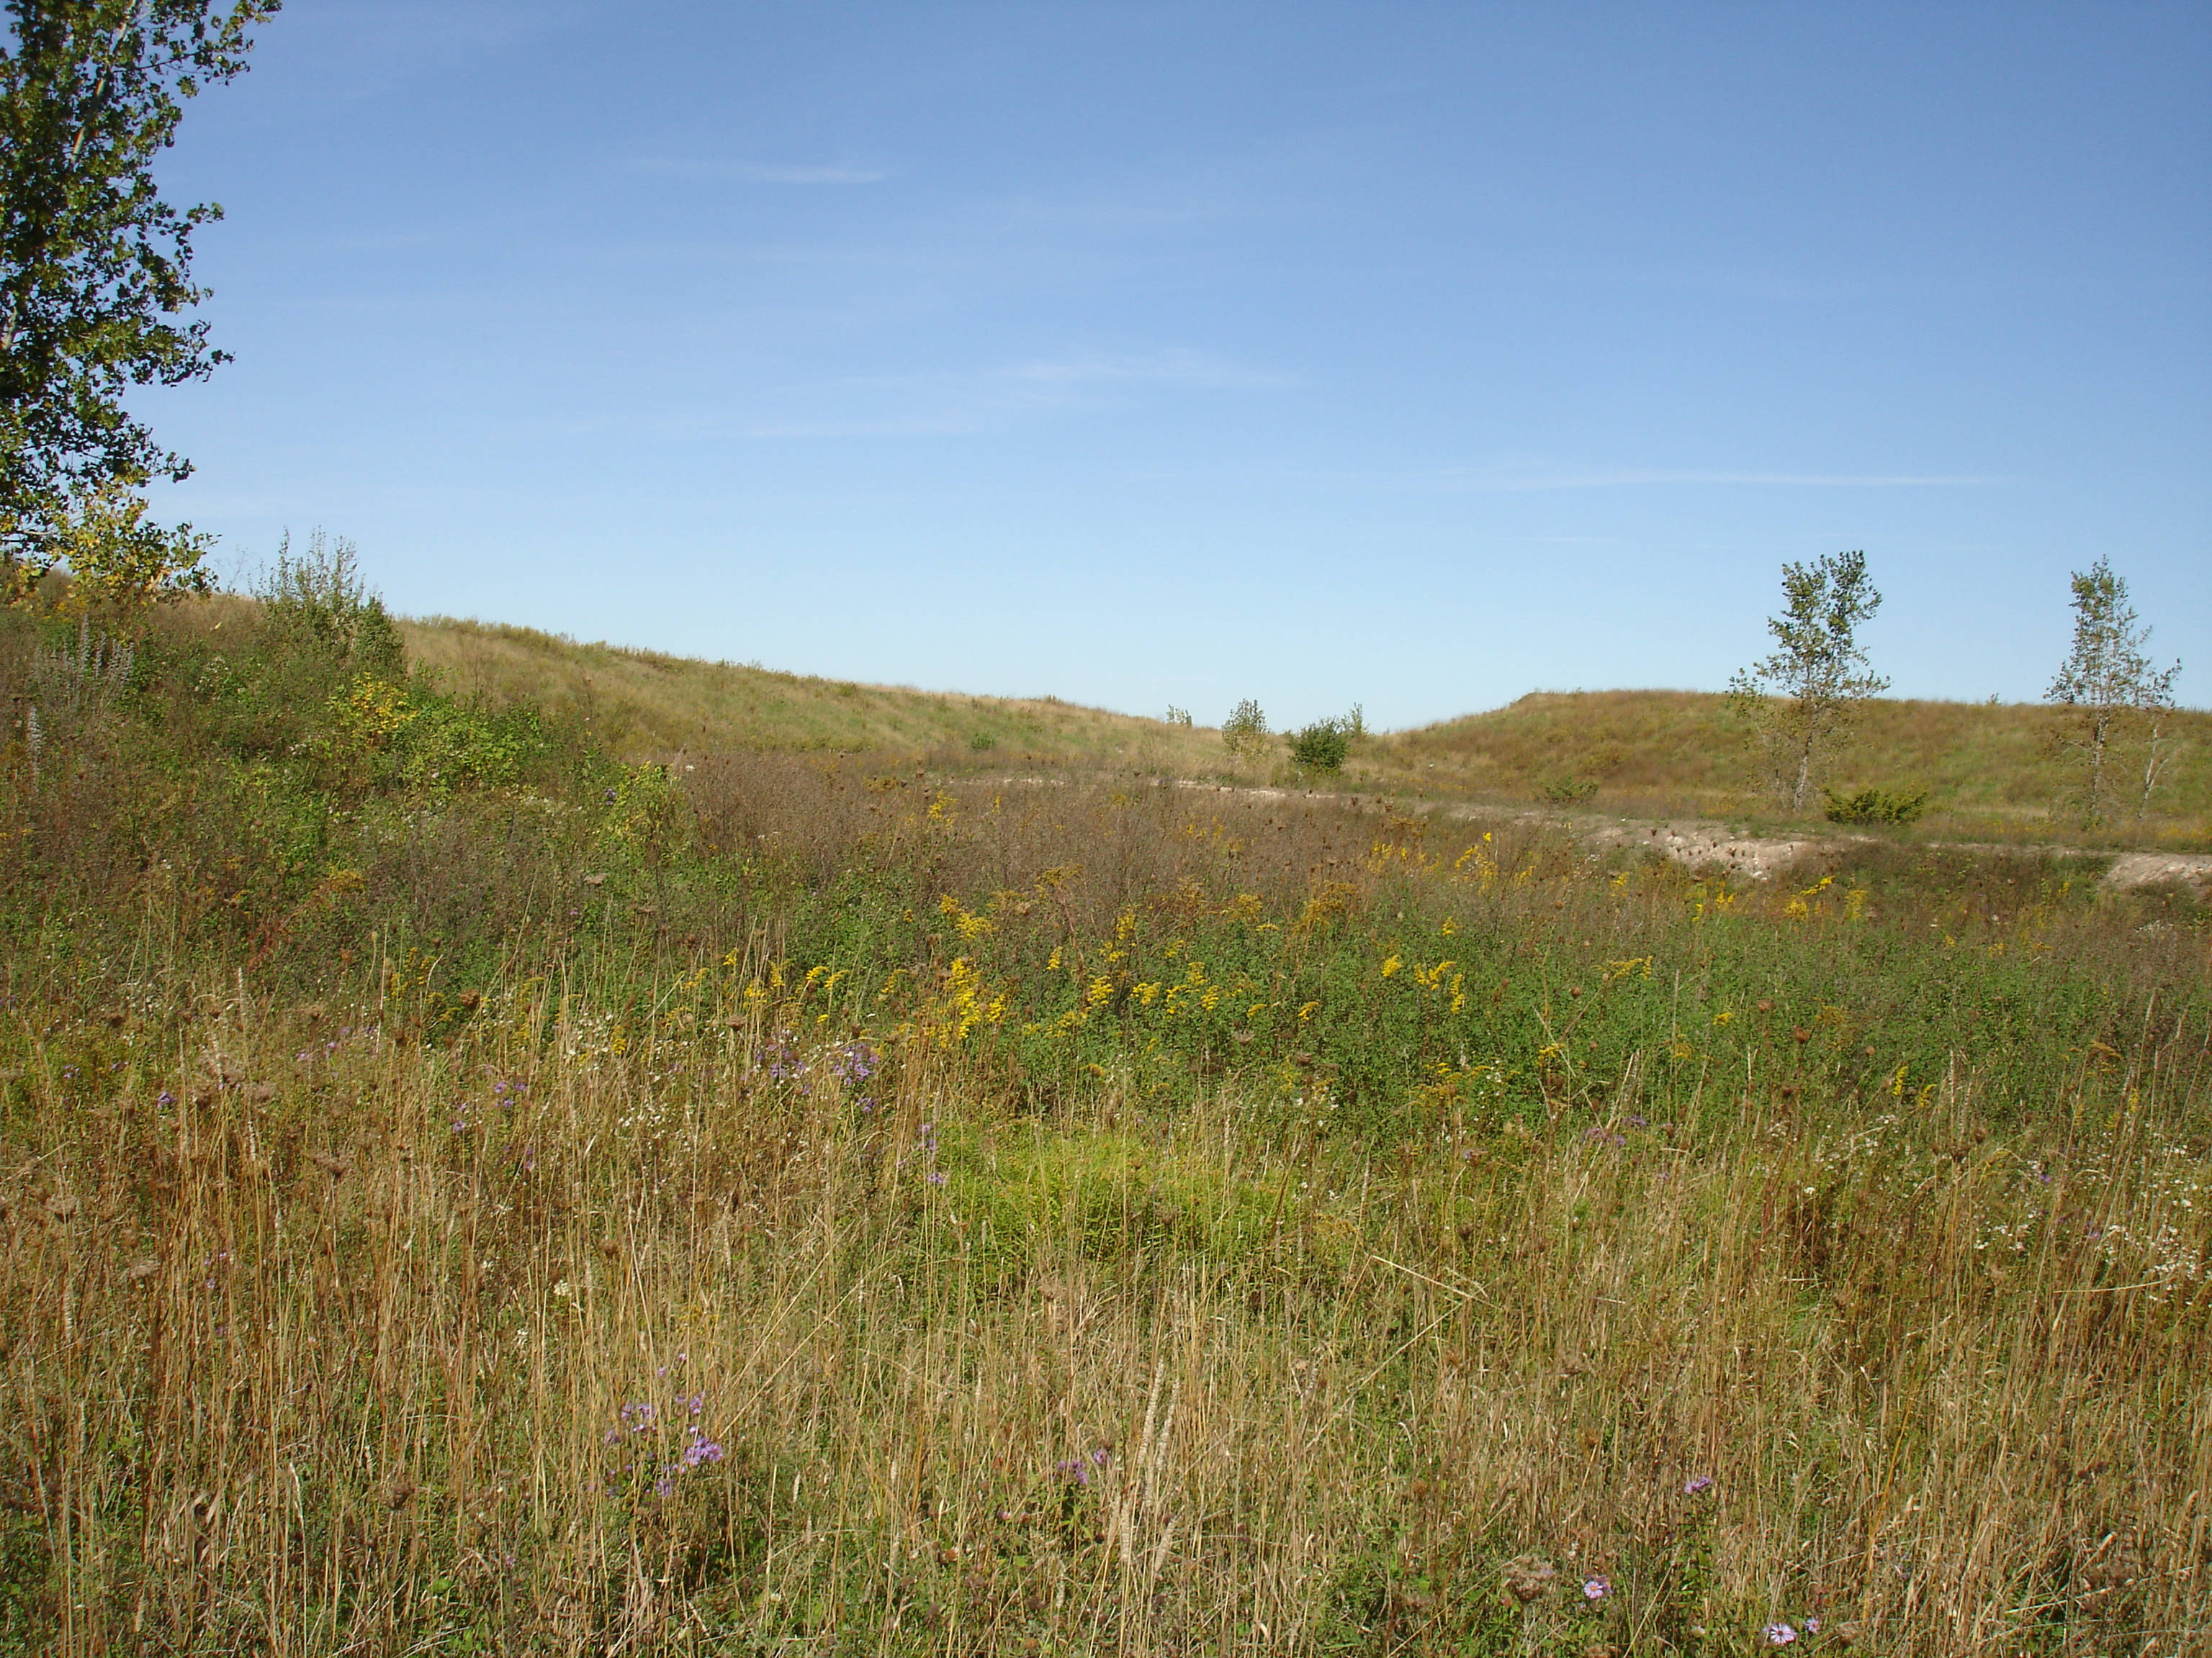
R.T. Vanderbilt Company, Inc. No. 1 and 2 Mines – Reclamation

Slide 11
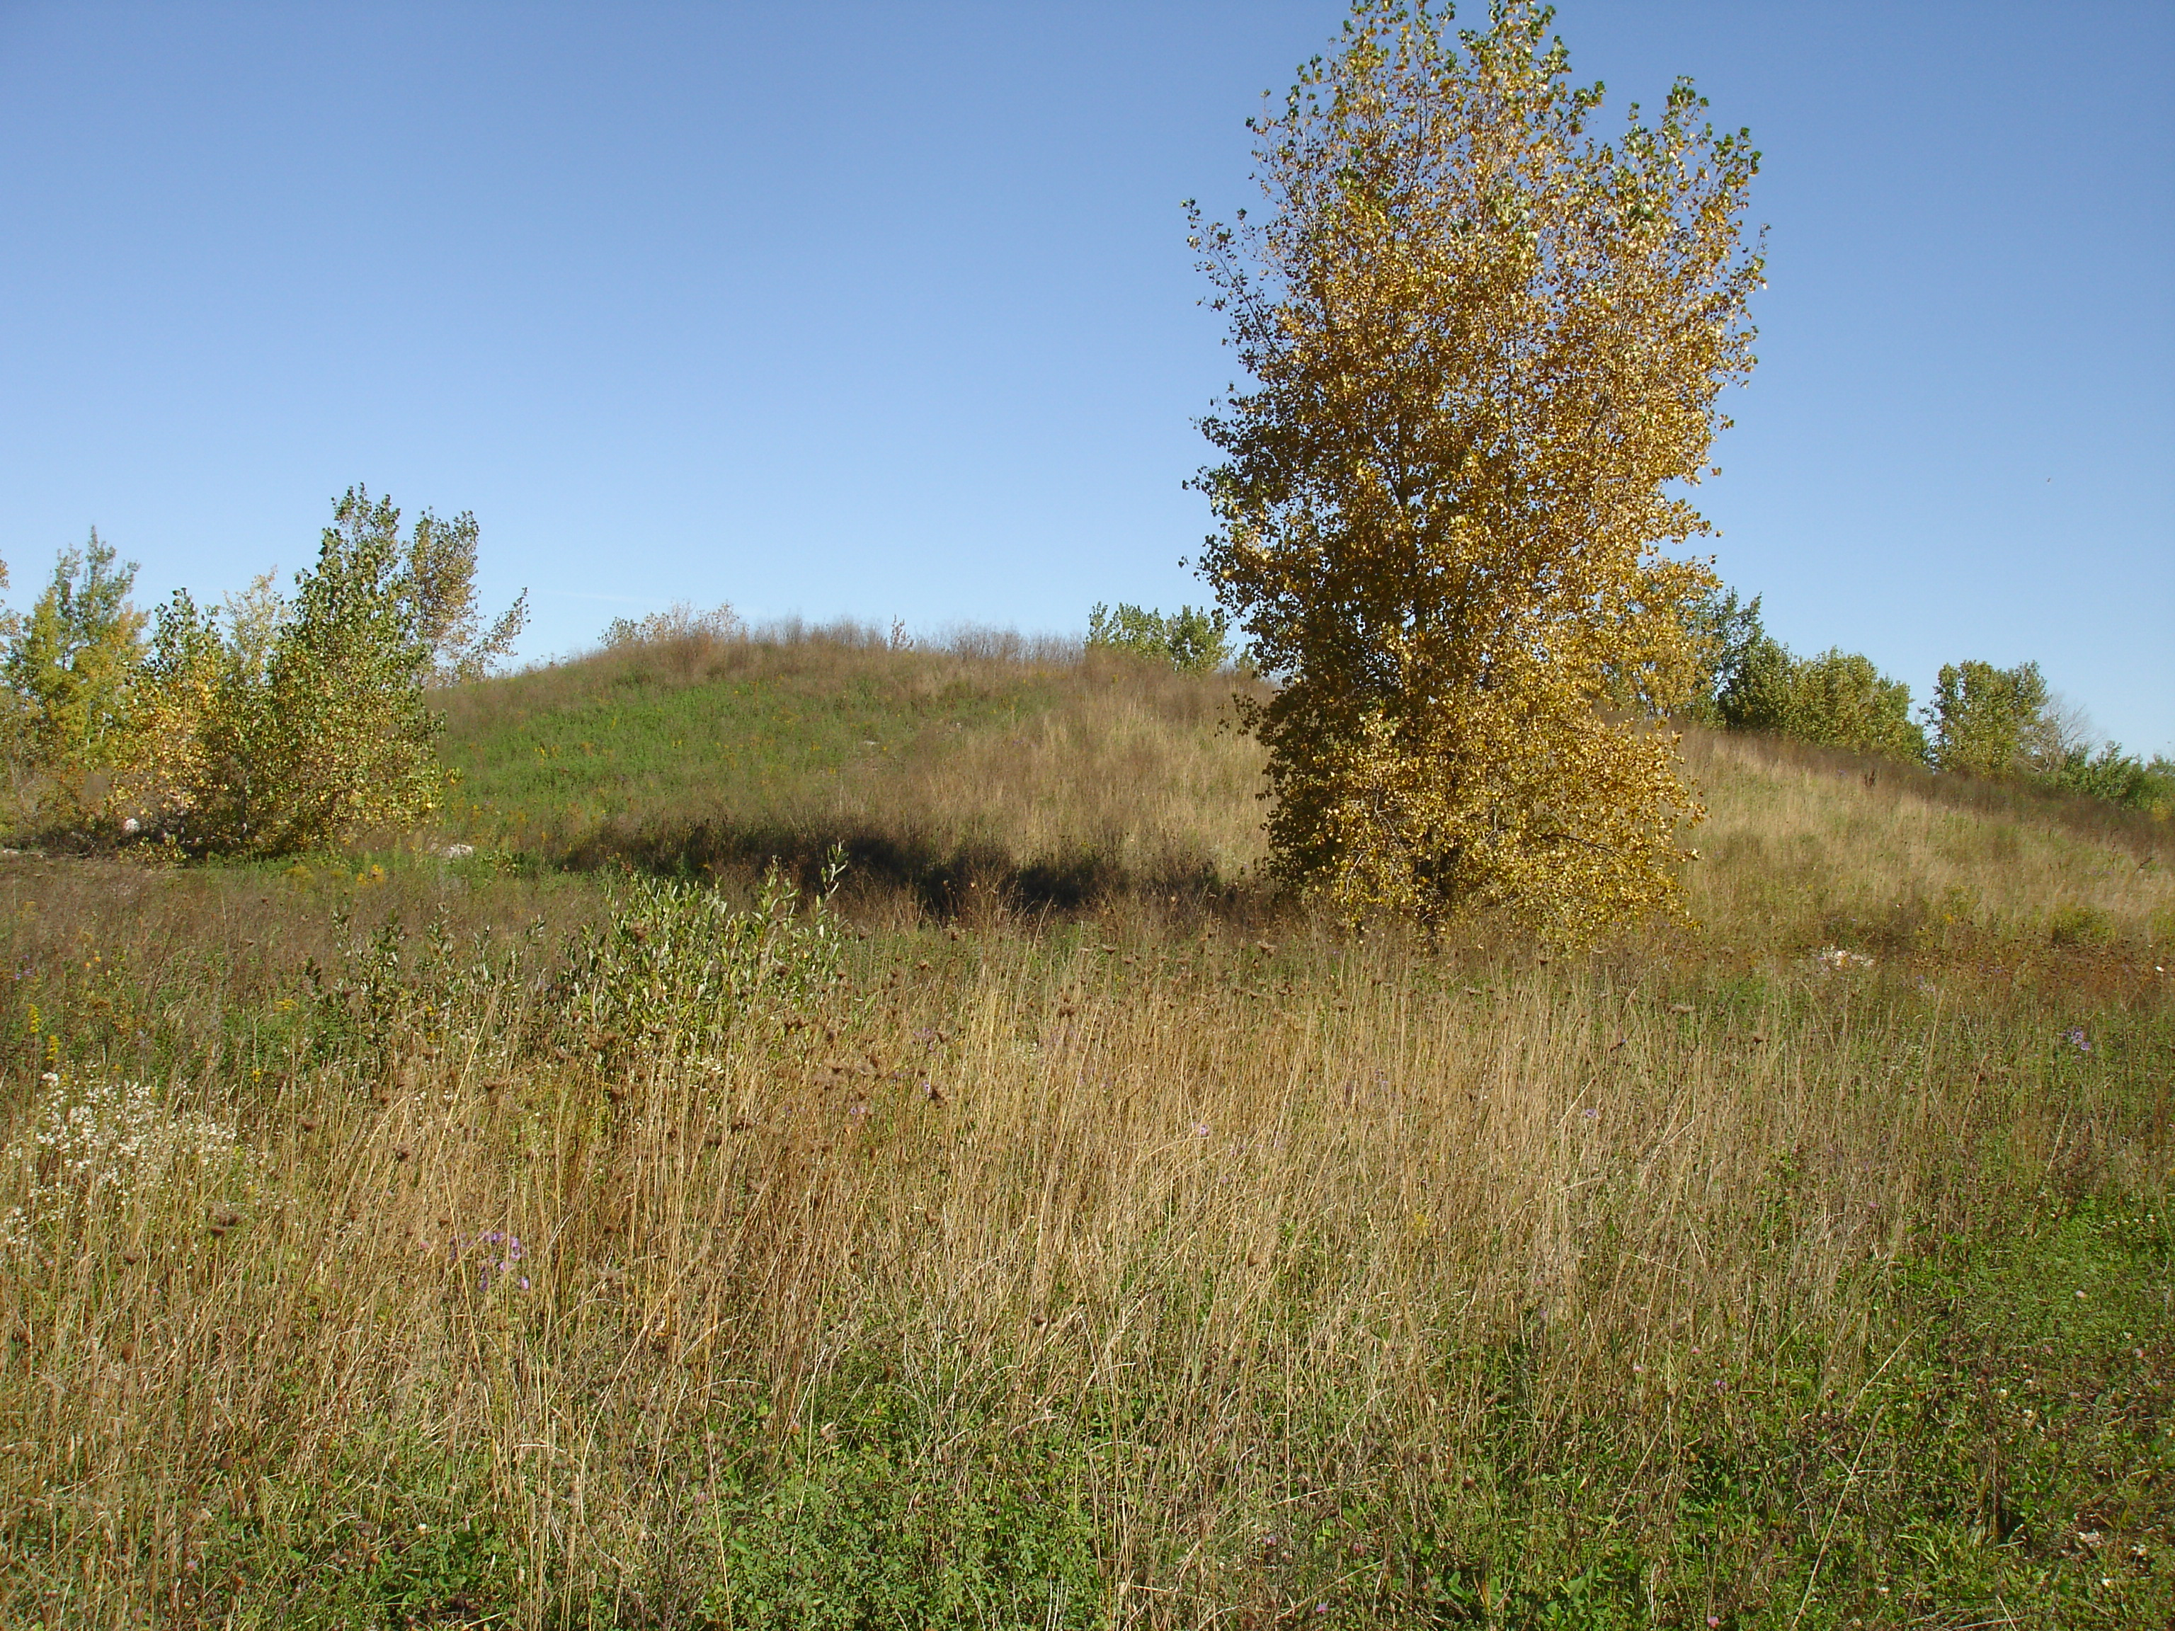
R.T. Vanderbilt Company, Inc. No. 1 and 2 Mines – Reclamation

